Slide 1
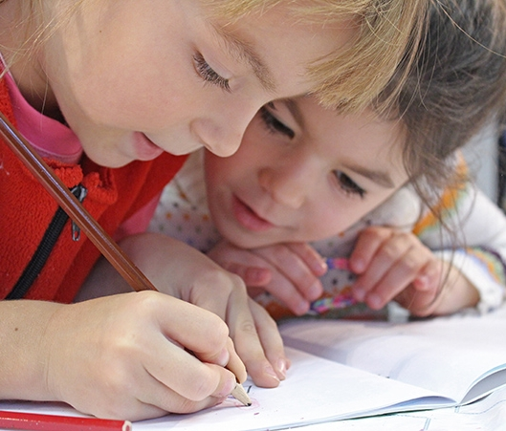
Meet the teacher
September 2024
Welcome to Year 2

Slide 2
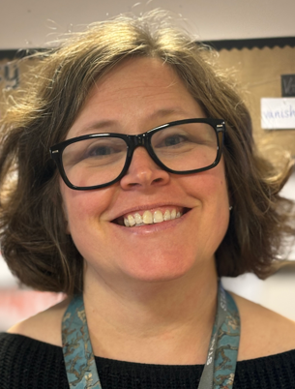
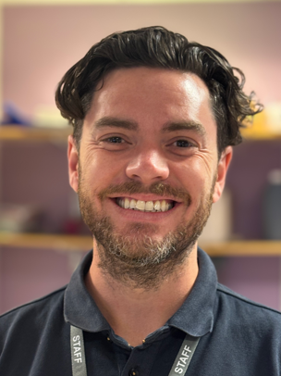
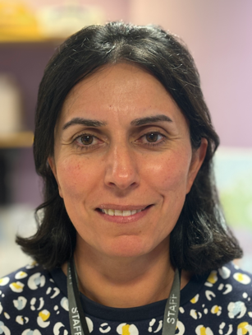
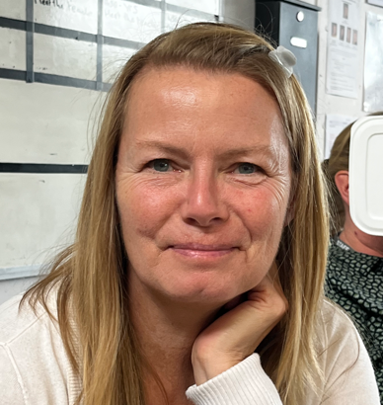
Staff
Badger Class – Mr Freeman
Fox Class - Mrs MacDiarmid
LSAs
Mrs Harvey
Ms Chambers

Slide 3
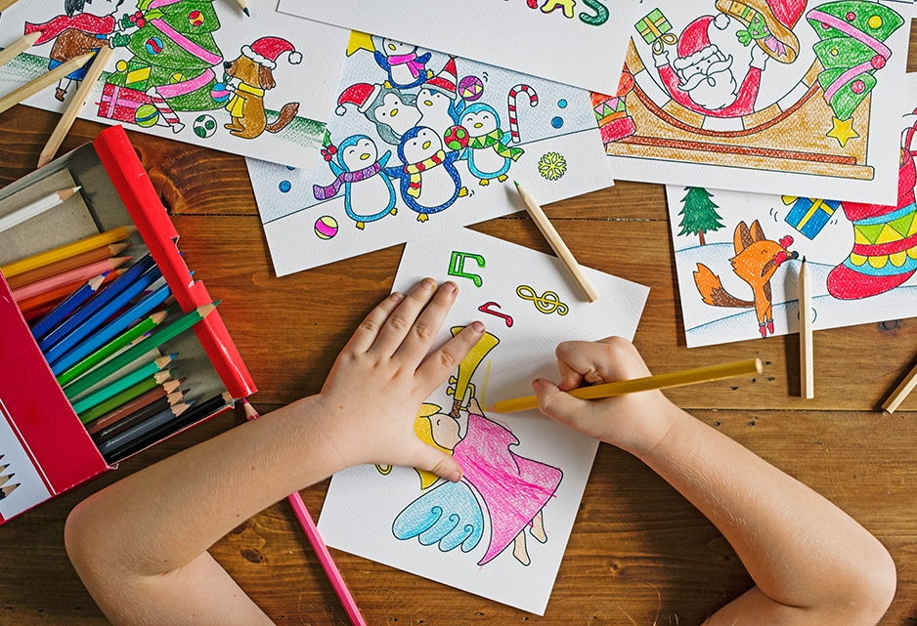
Our learning this year

Slide 4
Autumn Term
Phonics – Continuing the RWI journey
Literacy – character description, instructions, narrative, diary, recount
Guided Reading – various picture books followed by a Roald Dahl focus
Maths – Place value, addition and subtraction and shape
Science – materials and animals including humans
Topic – Geography (mapping), History (The swinging 60s)
DT – Food Art - drawing
RE - Christianity: What is God like for Christians? And Why is giving important to Christians?

Slide 5
Spring Term
Phonics – Continuing the RWI journey
Literacy – poetry, stories from other cultures, recounts, letters
Maths – money, multiplication and division, time, statistics
Science - Animals including humans and Plants
Guided Reading – various picture books, non-fiction focus and Toby and the Great Fire of London, Vlad and the Great Fire of London
Topic – Geography (China) History (The Great Fire of London)
DT – Mechanisms Art – Surface and colour
RE - Judaism: What is the Torah and why is it so important to Jewish families and Christianity: Why do Christians call Jesus the saviour?

Slide 6
Summer Term
Phonics – Continuing the RWI journey
Literacy – narrative, non-chronological reports, explanations
Guided Reading – The Curious Garden, Dear Greenpeace, Lady Daisy
Maths – position and direction, measurement, revision
Science – Living things and their habitats, plants
Topic – Geography (habits and climate – seaside focus) History (The Victorians)
DT – textiles Art – work in three dimensions
RE - Islam: Who is Allah and how do Muslims worship him? And What makes a good leader?

Slide 7
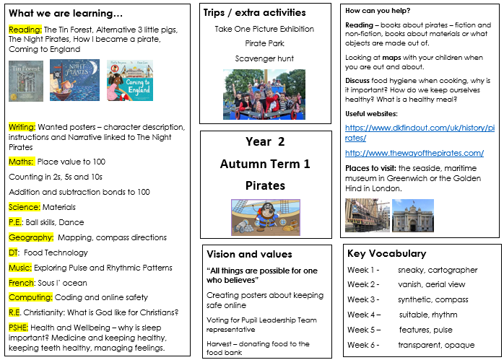

Slide 8
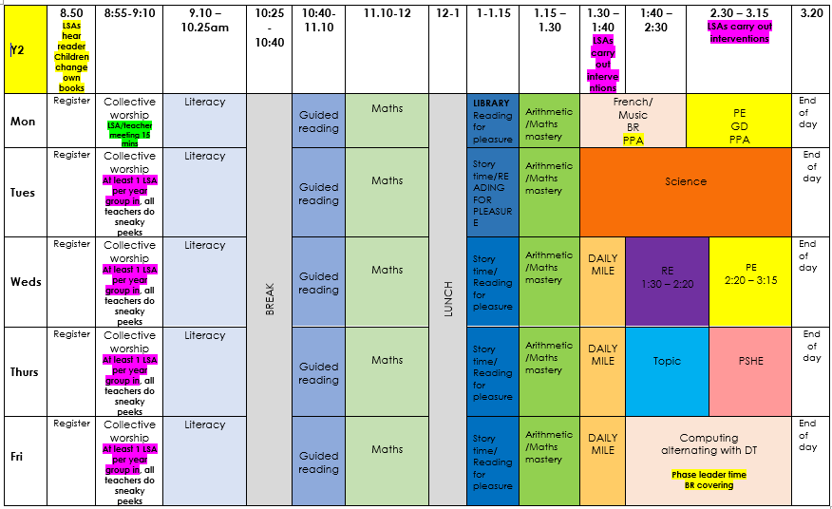
Timetable

Slide 9



Reading
This half term we are sharing books about pirates such as The Night Pirates, or The Pirates Next Door as well as books about materials such as The Tin Forest and alternatives to The Three Little Pigs.
Please continue to read with your children daily and record this in your reading records.

Slide 10
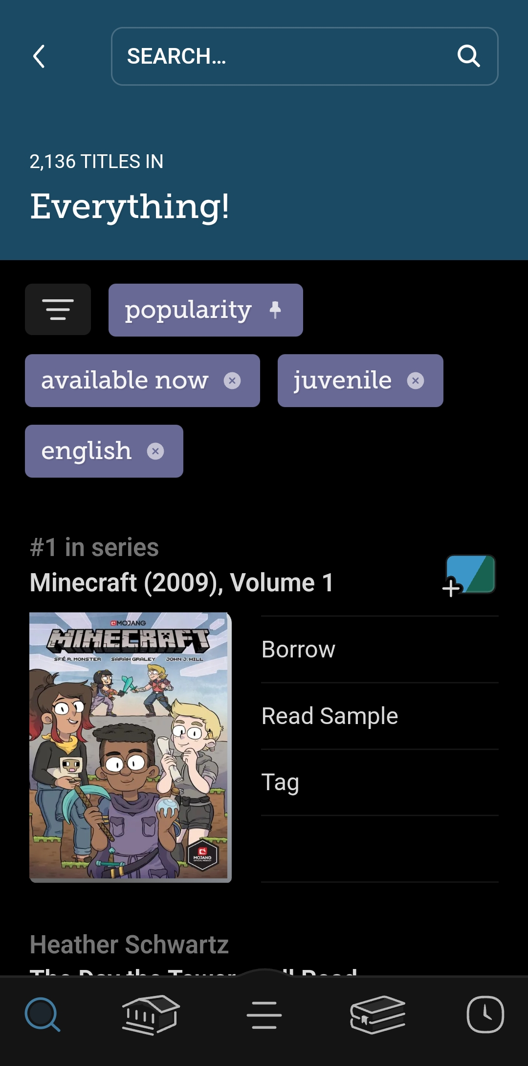
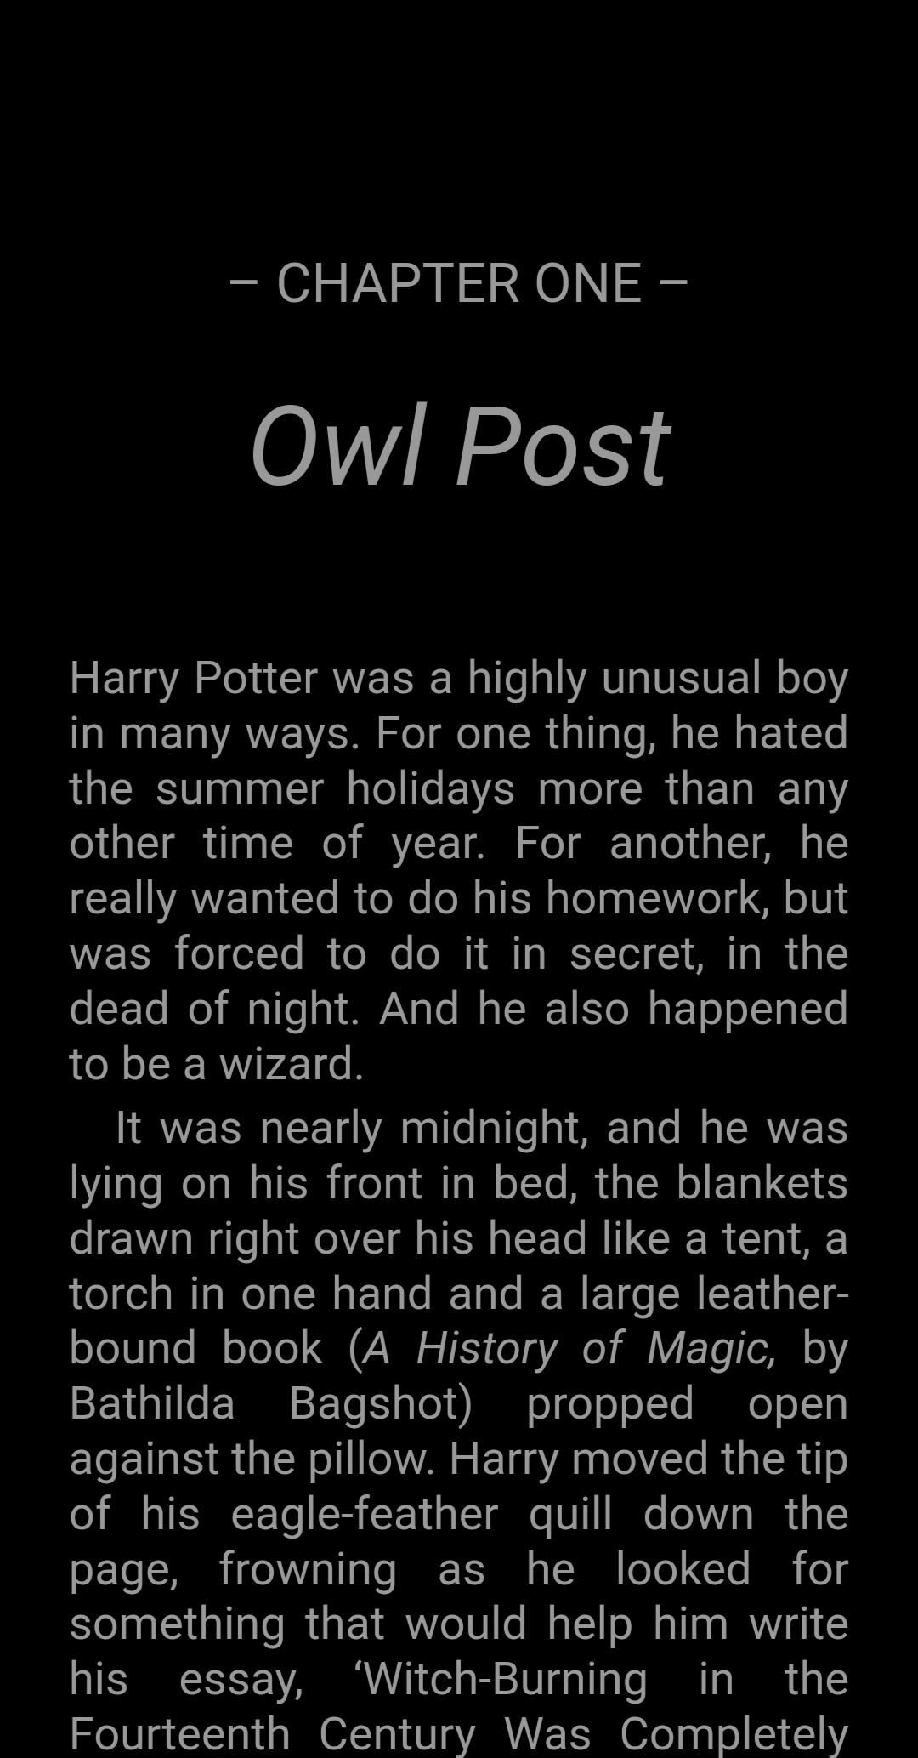

Reading - Libby
Sign up with your Surrey Library Card
Access e-books, comics, and audiobooks

Slide 11
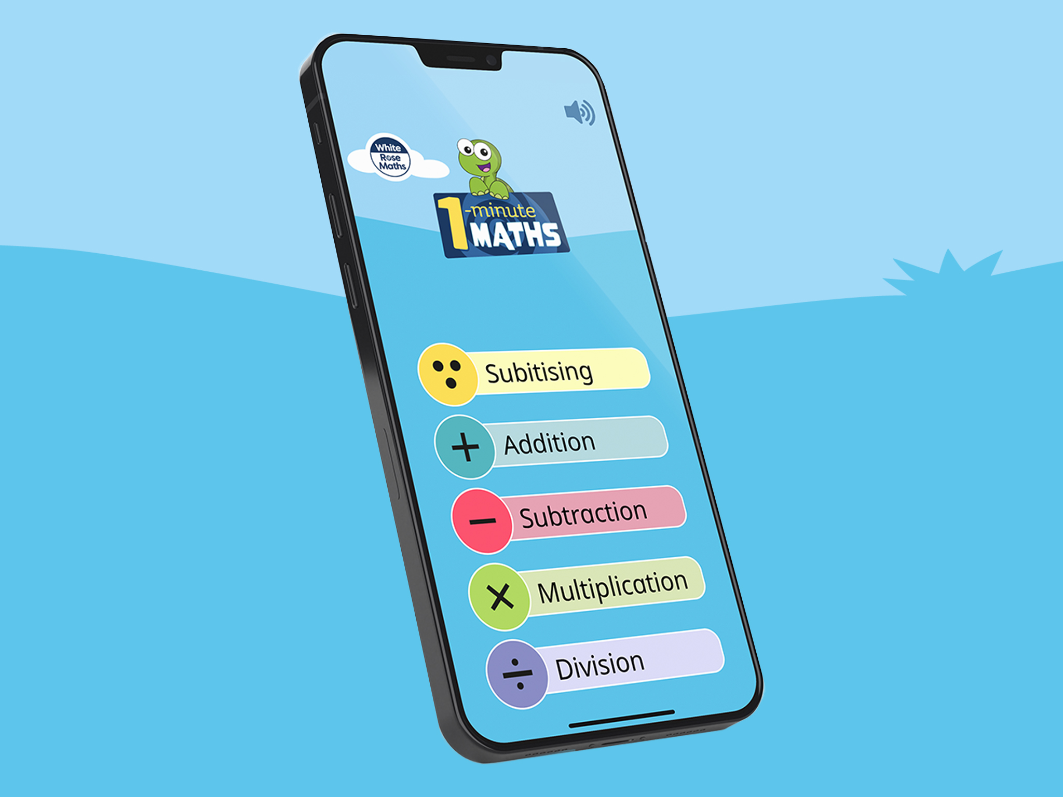
Whiterose app
Free app that supports our maths learning

Slide 12
Recognition board – all children recognised for positive behaviour
Re-direct, remind, caution – all done privately with the child
Time outs still take place but white slips are for recording purposes only
All adults responsible and consistent

Slide 13

Challenge for all
Small group interventions – pre teaching and keep up groups
Challenge across the curriculum
To help children access learning we use a variety of manipulatives such as numicon, base 10 (diennes), rekenrek, multilink etc
Challenge for all – all children are able to access challenge and we are avoiding using glass ceilings for all children

Slide 14
Listen to your child read and promote a love of reading
Encourage your child to complete their weekly home learning and hand it in on Wednesdays
Allow and encourage your child to access the online resources e.g. numbots, ed shed,
Ensure your child has the correct named uniform and equipment
If you have any spare time, we are always looking for volunteer readers.

Slide 15
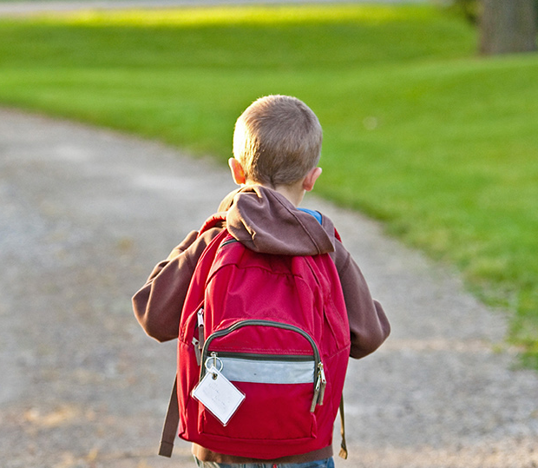
Thank You!
Any questions?

