Slide 1

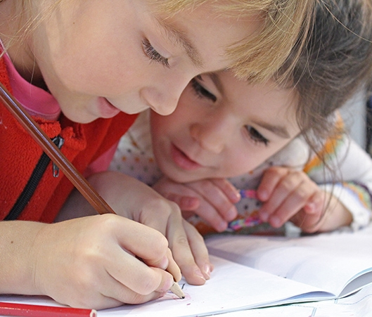
Meet the teacher
September 2026
Welcome to Year 4

Slide 2

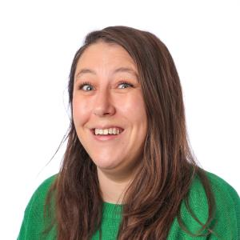
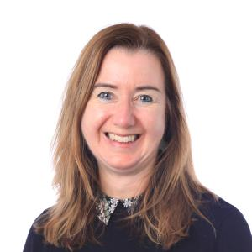
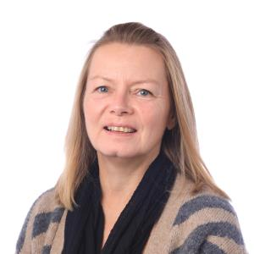
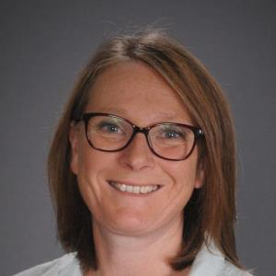
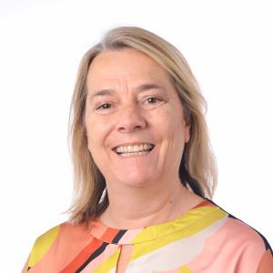
Staff
Oak class
Miss Stretch
Mrs Brown – LSA
Mrs Celine - LSA
Willow class
Miss Tolley
Mrs Chambers – LSA (Monday, Tuesday and Wednesday)
Mrs Oakhill – LSA (Thursday and Friday)

Slide 3
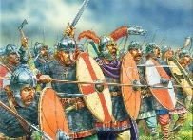
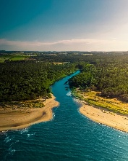
Autumn term
History - what changed in Britain after the Anglo-Saxon invasion?
Geography - what are rivers and how are they used?
Art - story telling through drawing
DT - electrical systems
Science - animals including humans and electricity
Computing - animation and Logo
PSHE
  how can I take care of my mind and body?
  what rights and responsibilities do we have?
RE
  what did God promise his people?
  how do non-religious people celebrate new life?
PE - netball, football, swimming and ball skills
Music - let your spirit fly
French - getting to know you
Anglo-Saxon workshop in school
Box Hill visit

Slide 4
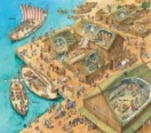
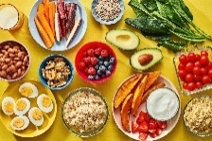
Spring term
History – were the Vikings raiders, traders or settlers?
Geography – where does our food come from?
Art – exploring pattern and exploring still life
DT – mechanical systems
Science – states of matter
Computing – branching databases and sound stories
PSHE
  how can we prevent illness and injury and respond if they happen?
  how can I make healthy choices?
RE
  what did Jesus say about God’s kingdom and why is it ‘good news’?
  is communion a celebration or an act of remembrance?
PE – tag rugby, hockey, dance and gymnastics
Music - glockenspiels
French – family and friends
Tate Britain
Food and fair trade workshop

Slide 5


Summer term
History - how did the achievements of the Ancient Maya impact their society and beyond?
Geography - why are rainforests important to use?
Art - working in three dimensions – the art of display or sculpture
DT - textiles (2D shape to 3D product) - purses
Science - living things and habitats and sound
Computing - coding and touch typing
PSHE
  how can I spend money wisely?
  how will my body and emotions change as I grow up?
RE
  are words more important than actions?
  How does worship show what is important to Muslims?
PE - rounders, tennis, athletics and cricket
Music - three little birds and reggae
French - holidays and hobbies
Samba drumming
Mosque

Slide 6
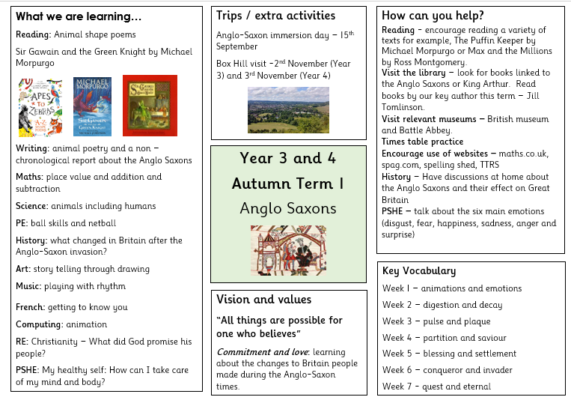

Slide 7
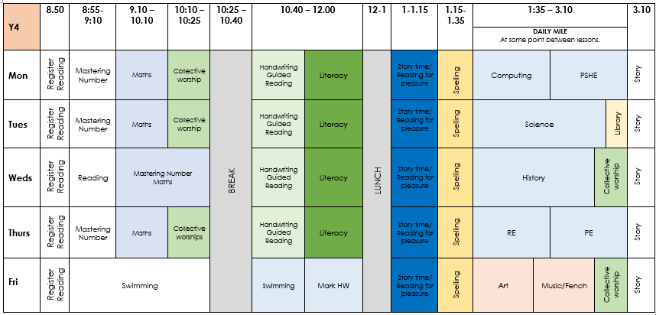
Timetable

Slide 8









Literacy
Texts have been carefully chosen to link with the wider curriculum learning.
Year 3 and 4 will perform
The Tempest in Spring 2

Slide 9











Reading
Fiction books
Key authors
Jill Tomlinson
Cressida Cowell
Michael Rosen
Non-Fiction books

Slide 10

Reading
Home Reading
5 times (weekly)
Adults record brief comment/signature
Half termly class reward linked to reading
Reading to your child
Audio books
Library
Reading bingo (Home Learning)
Reading at school
Guided Reading including Readers Theatre
Reading across the wider curriculum lessons
Reading for pleasure (afternoon)
Morning reading

Slide 11
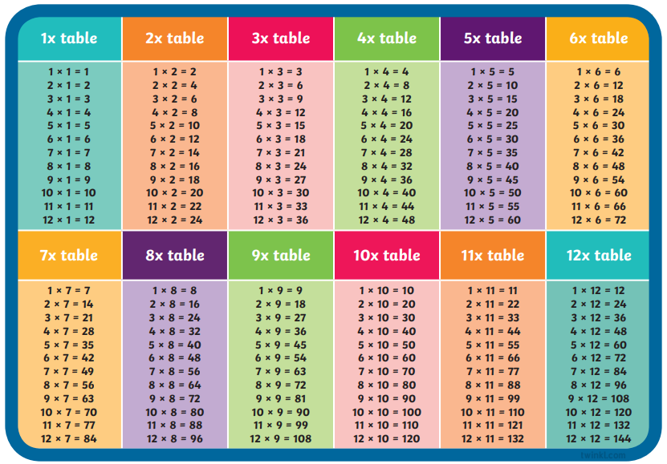

Multiplication Check
Add pictures of key texts
In Year 4, all children are required to complete a times table check to test their recall on all times tables facts.
We strongly recommend you use the soundcheck on Times Tables Rockstars to practice.
Other ideas: Hit The Button, listening to times table songs, writing them out or creating your own games with them.

Slide 12


Supporting maths at home:
Incorporate mathematics into everyday routines and activities; telling the time, using money and coins or counting and comparing quantities.
Use maths talk every day. Focus on concepts like doubling/halving and adding/subtracting. If I ate half the peas on your plate for you, how many would you have left?”
Ask your child to teach you new strategies and solve problems taught in class.
Play maths games together. Many games use mathematical and logical skills that your children will need in later life - plus they’re fun! Games like jigsaw puzzles help children to develop logical & spatial awareness skills.
Use fractions in daily life. Can you find ½ of the sweets? What fraction of the cake has been eaten?
Practice times tables and maths games online. Times table rock stars, Sumdog, Hit the Button are all useful websites.
If they need a challenge… Explore websites such as NRICH (http:// nrich.maths.org/) or Transum (http://www.transum.org/)

Slide 13
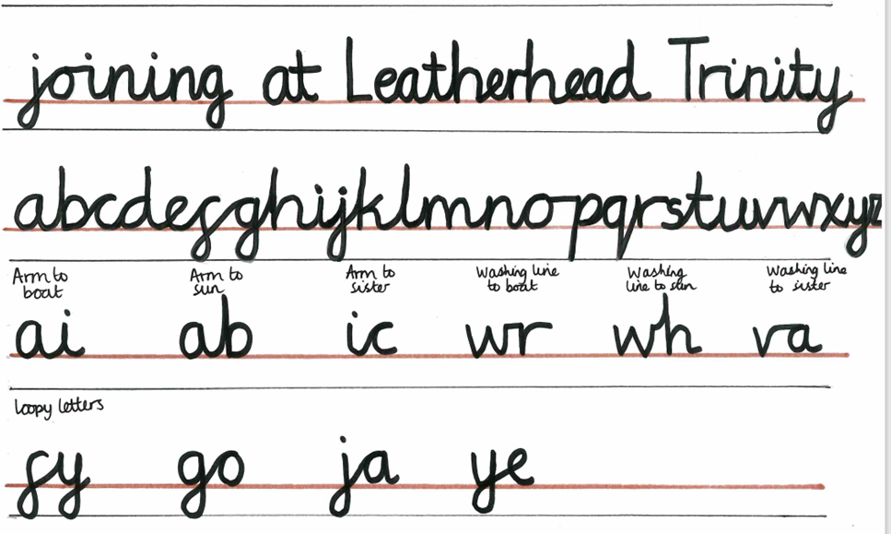
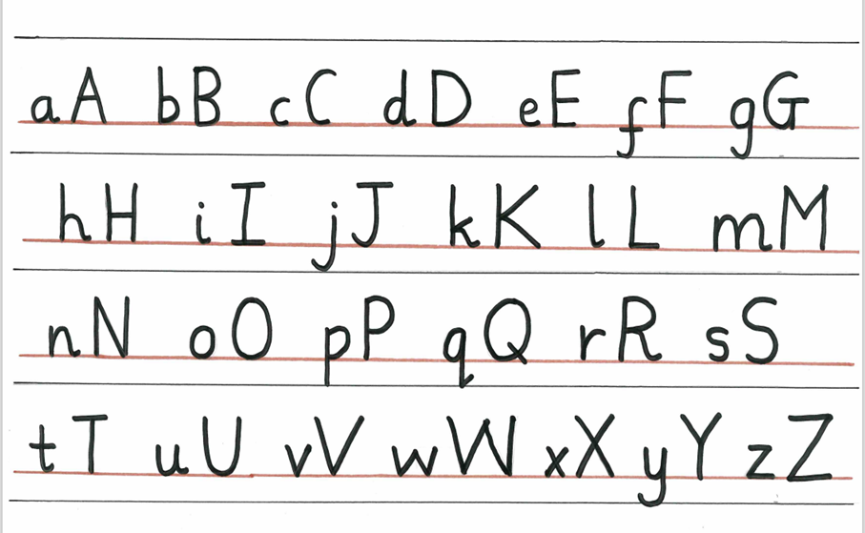
Handwriting + Presentation

Slide 14
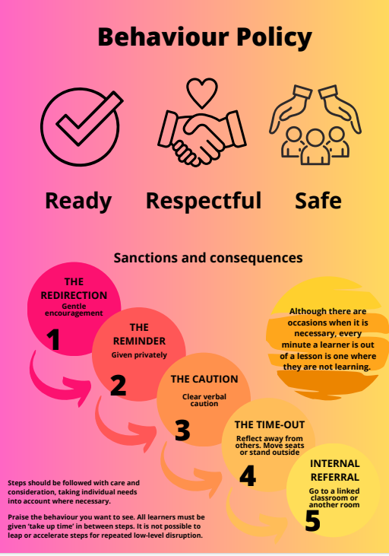

Slide 15
Ready, Respectful, Safe
Recognition board – all children recognised for positive behaviour
Re-direct, remind, caution – all done privately with the child
Time outs still take place but white slips are for recording purposes only
All adults responsible and consistent

Slide 16

Ready, Respectful, Safe
Supporting us to help your child be ‘Ready’ for their learning:
  Sleep
  Filling breakfast
  Attendance/punctual
  Supporting our rules: Ready, Respectful and Safe
Home Learning
Trips/walkers

Slide 17
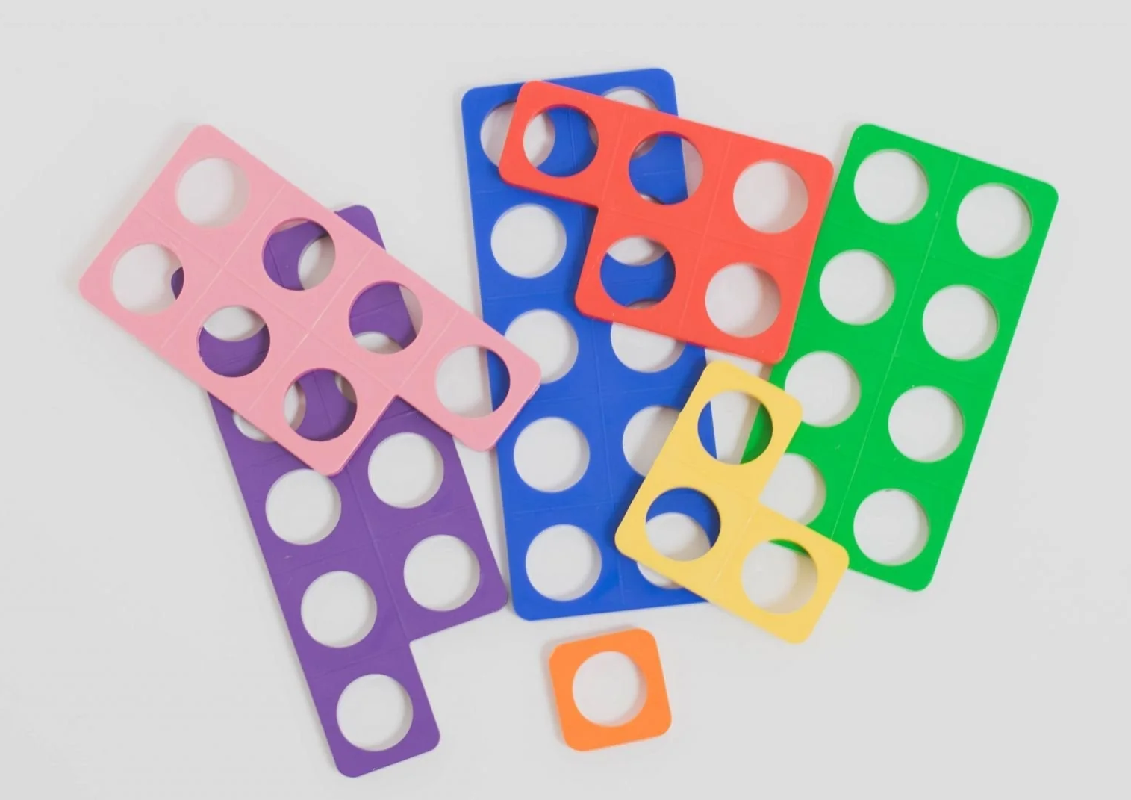
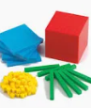
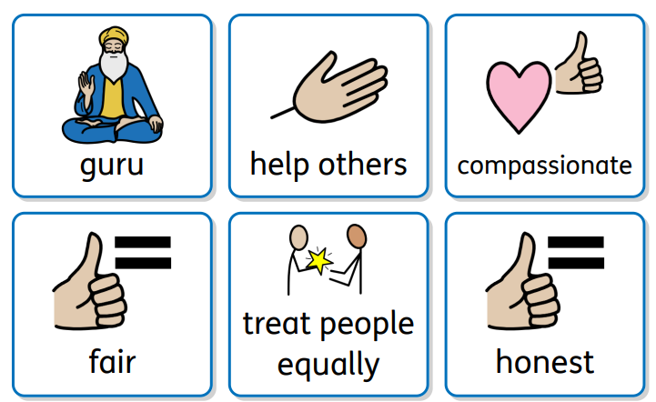
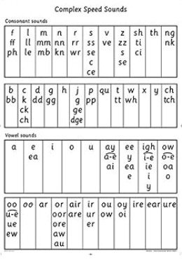
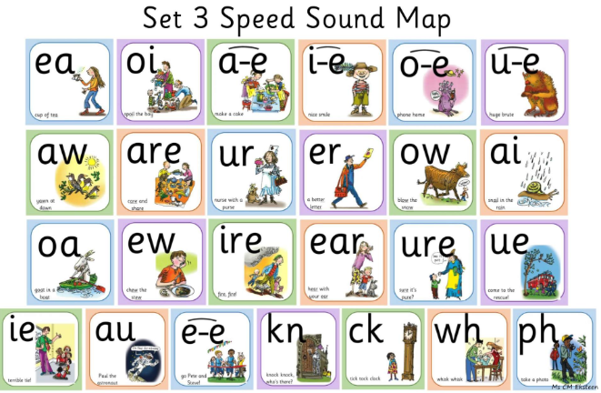
Challenge for all
Helping children to access their learning:
Manipulatives (dienes and numicon)
RWI sound mats
Widgits (word banks)
Challenge for all
All children able to access challenge

Slide 18
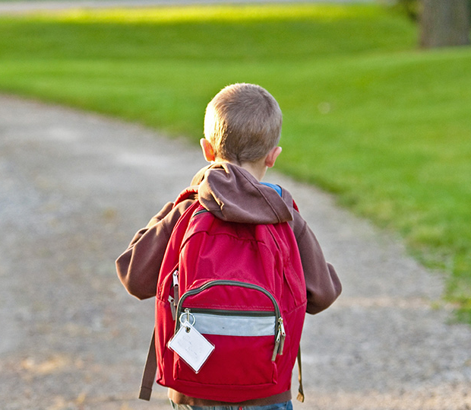
Thank You!
Any questions?

