Slide 1


Meet the teacher
September 2026
Welcome to Year 1 & 2

Slide 2
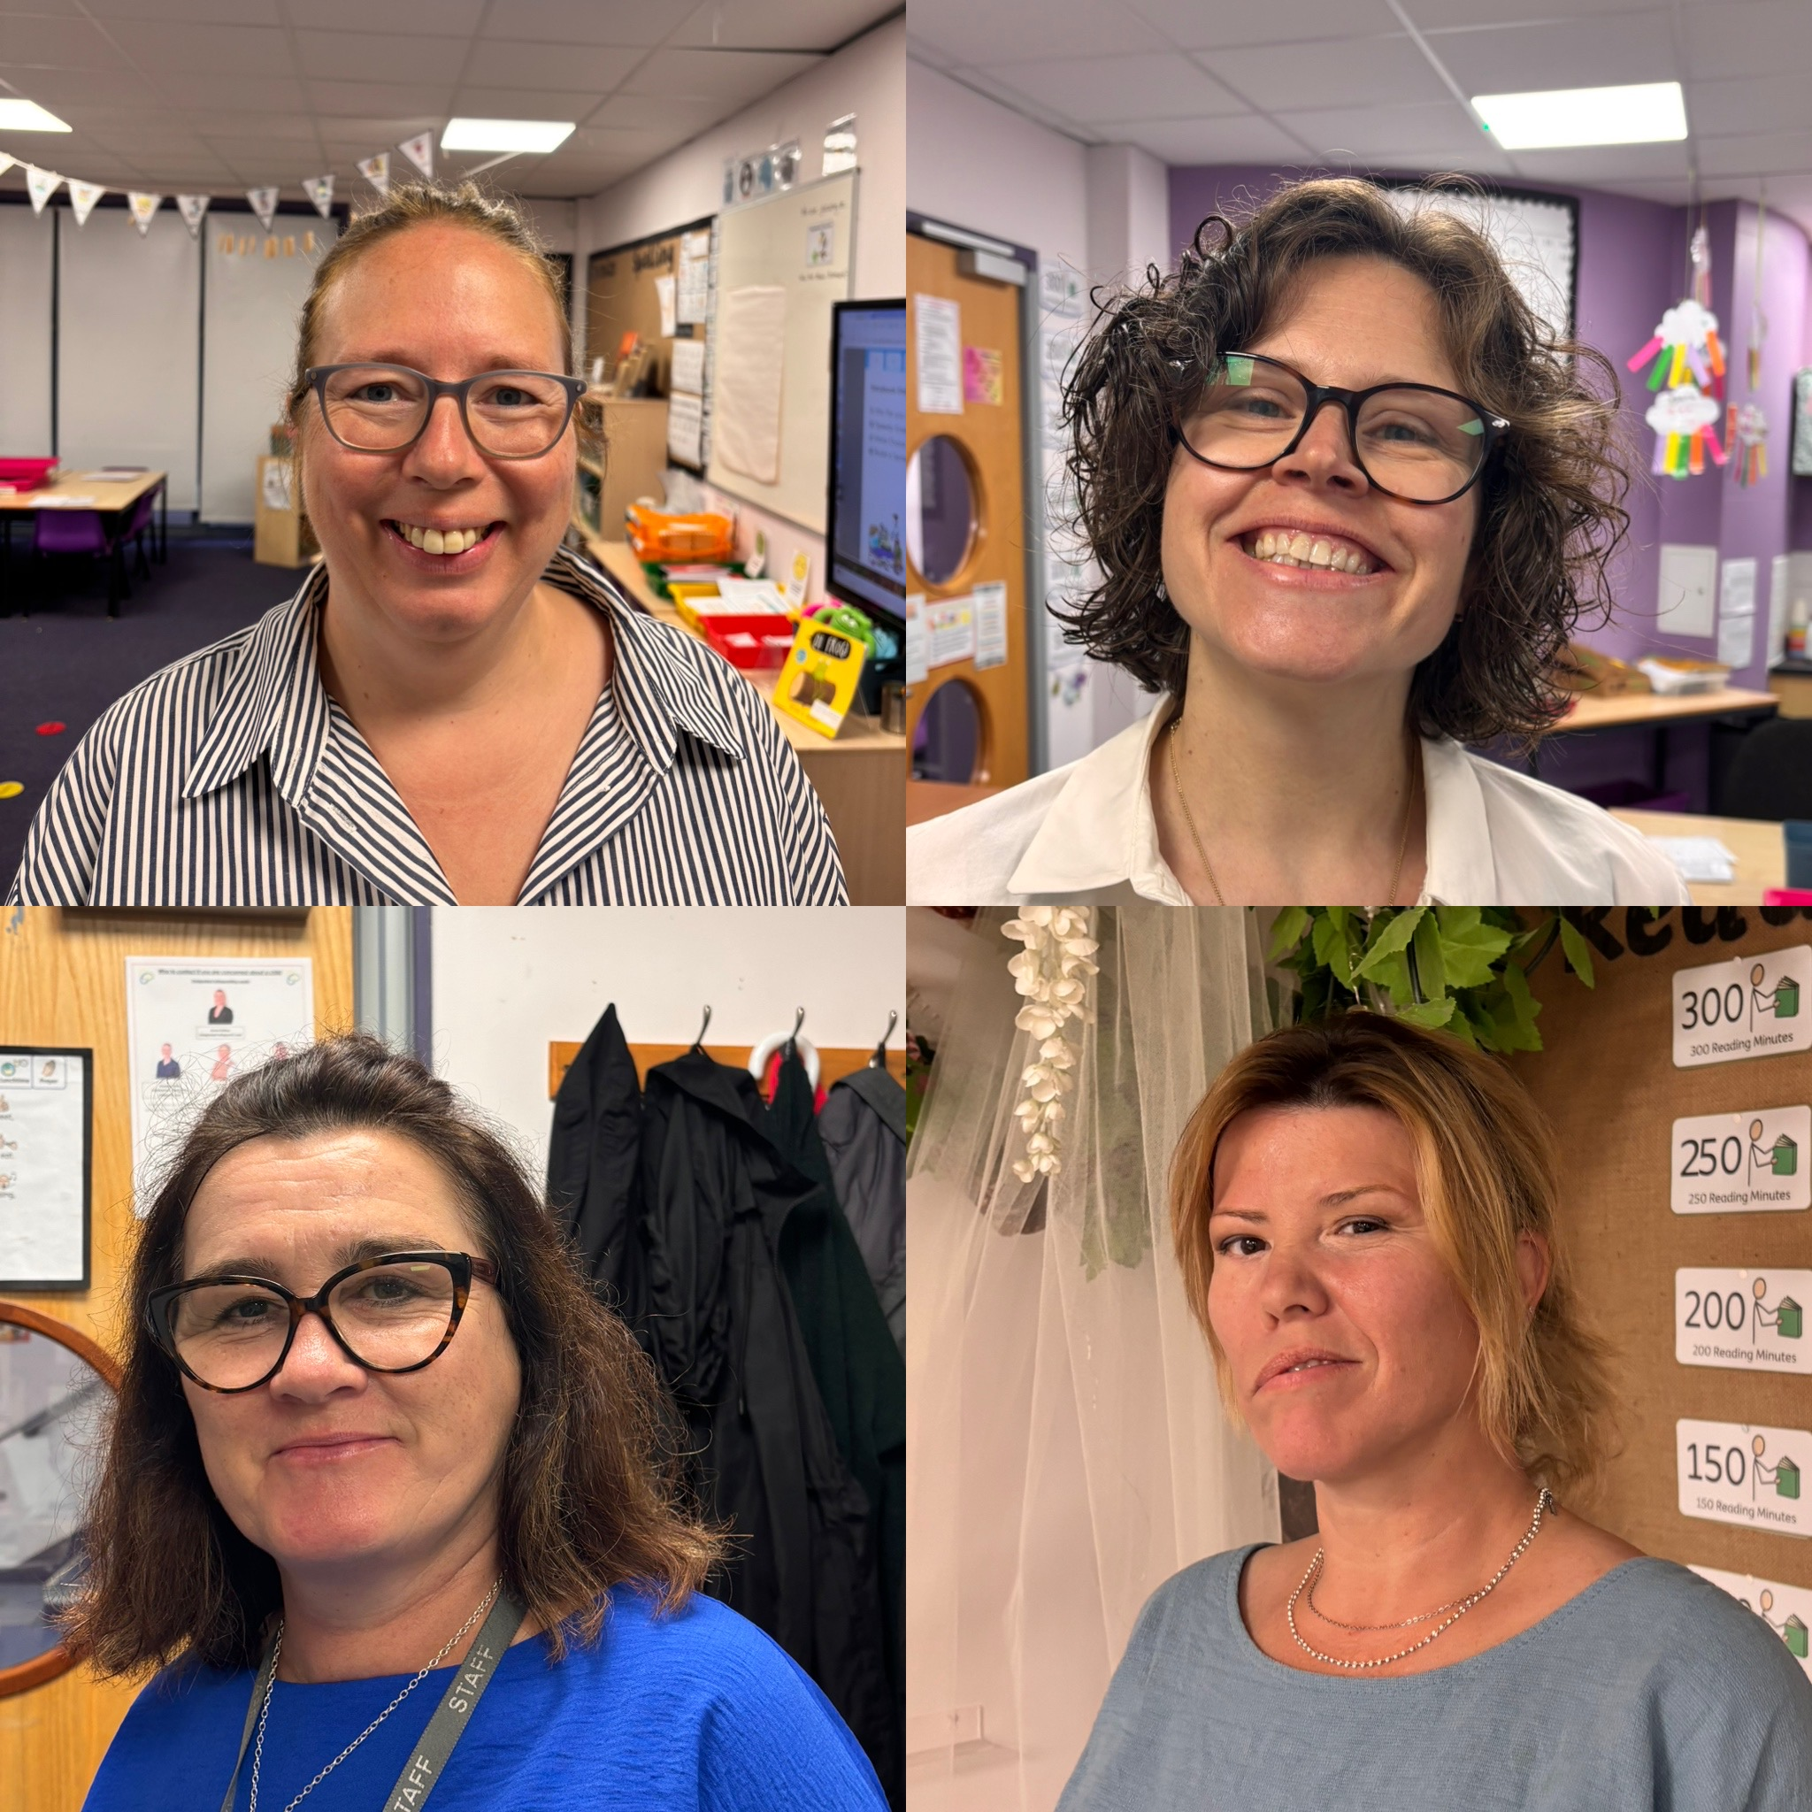
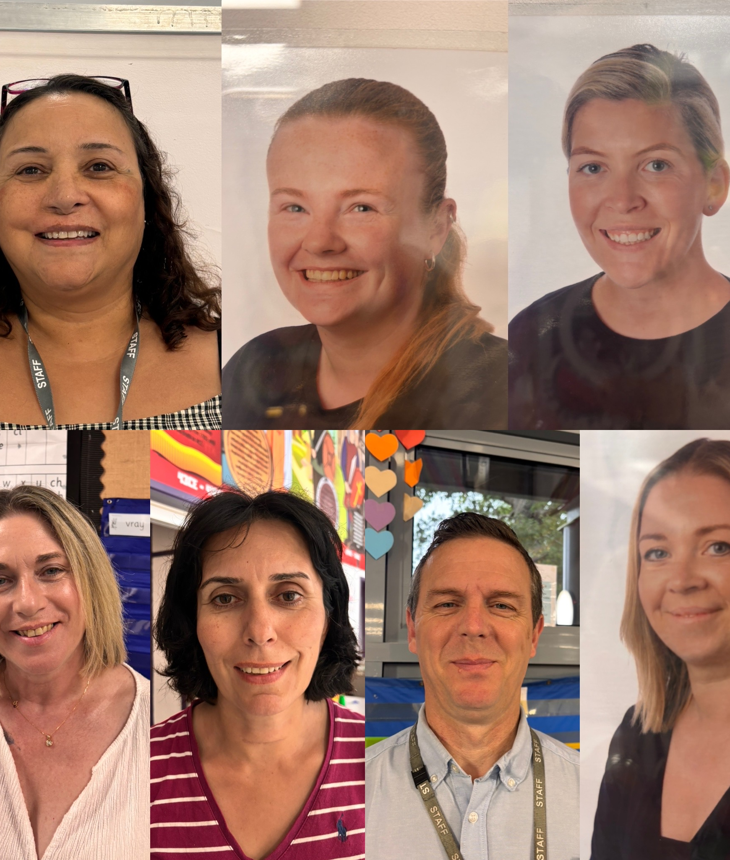
Staff
Add photos of staff
Teachers
Mrs Tubby and Miss McSweeney (Badger Class)
Ms Inci (Squirrel Class)
Mrs MacDiarmid (Rabbit Class)
Ms Forrester (Dragonfly Class)
LSAs
Ms Rivet, Mr Muttit, Mrs Ives, Mrs Smythe, Mrs Harvey, Miss Blackley,

Slide 3
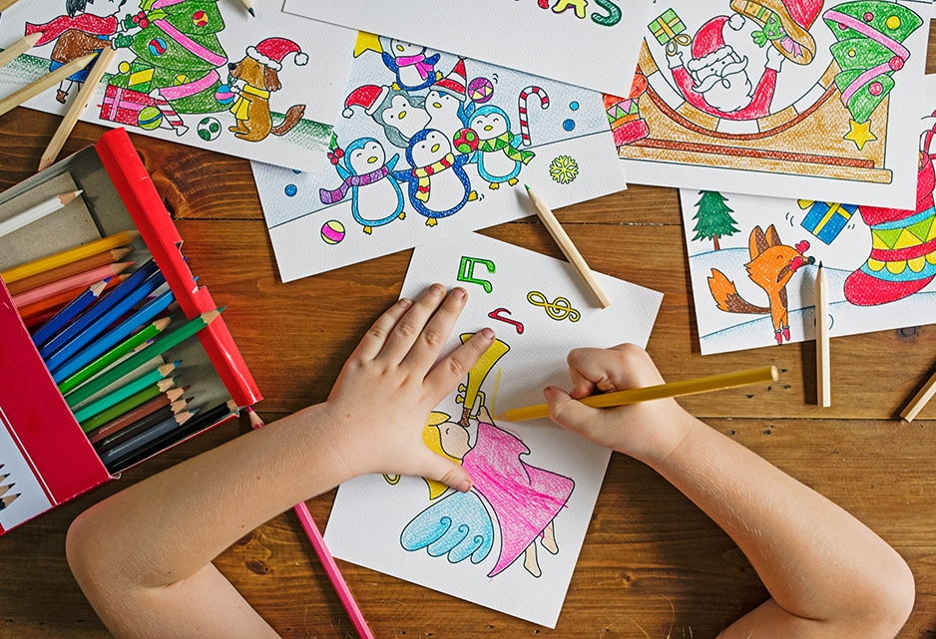
Our learning this year

Slide 4
Autumn Term
Phonics – continuing the RWI journey
Literacy – narrative, handwriting, sentence structure
Guided Reading – various picture books
Maths – Place value, addition and subtraction and shape
Science – Animals including humans
Topic – Geography (What is it like here?), History (How am I making history?)
DT – Structures Art - drawing
RE - Christianity: Why do Christians call God ‘creator’? What is the Nativity and why is it important to Christians?

Slide 5
Spring Term
Phonics – Continuing the RWI journey
Literacy – poetry, stories from other cultures, recounts, letters
Maths – Yr 1 – Place Value (within 20), addition and subtraction (within 20) , Place value (within 50), Length and Height, Mass and Volume
Yr 2 - money, multiplication and division, time, statistics
Science – Weather, materials
Guided Reading – various picture books, non fiction books linked to our topic
Topic – Geography (What is the weather like in the UK?) History (How have toys changed?)
DT – Food Art – Print
RE - Judaism: Why do Jewish families celebrate the gift of Shabbat? Christianity: What do Christians learn from the stories of Jesus?

Slide 6
Summer Term
Phonics – Continuing the RWI journey
Literacy – narrative, non-chronological reports, explanations
Guided Reading – Various picture books and non fiction books linked to our topics
Maths – Yr 1 – Multiplication and division, fractions, position and direction, place value (within 100), money and time
Yr 2 - position and direction, measurement, revision
Science – materials continued, plants
Topic – Geography (What is it like to live in Shanghai?) History (How have explorers changed the world?)
DT – mechanisms Art – work in three dimensions
RE - Islam: What is important for Muslims families? Why should we look after the world?

Slide 7
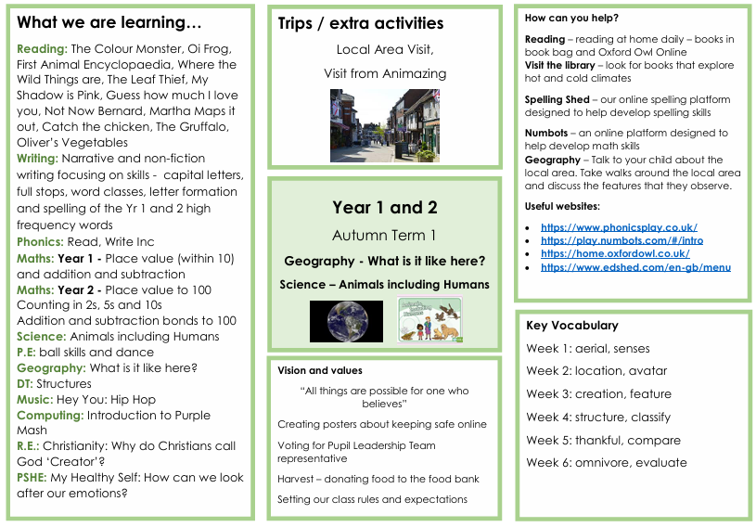

Slide 8
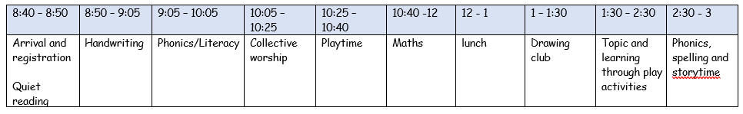
Timetable

Slide 9

Reading
Phonics Screening Check – week commencing
14th June
Add pictures of key texts
Reading is one of the most important things that you can do with your child to support their learning.
Children should be encouraged to read but it is vitally important for them to see reading as a pleasure.
Let your child see you read.
Take them to the library
Listen to audio books
Read to your child
And most importantly talk to them about what they are reading.
If your child is reluctant to read keep the session short and give lots of praise – gradually build the time up but keep reading!
Please continue to read with your children daily and record this in your reading records.

Slide 10
Please ensure all reading books and records are in school every day. Class teachers will hear all children read over a two week timetable. This is in addition to daily reading in Read Write Inc, sessions.
Suggestions to help with reading:
Quality over quantity – between 5 and 10 minutes daily
Take turns in reading pages
Read the book and child ‘jumps in’ with missing words
Speak to your child’s class teacher
Notes:
Duygu

Slide 11
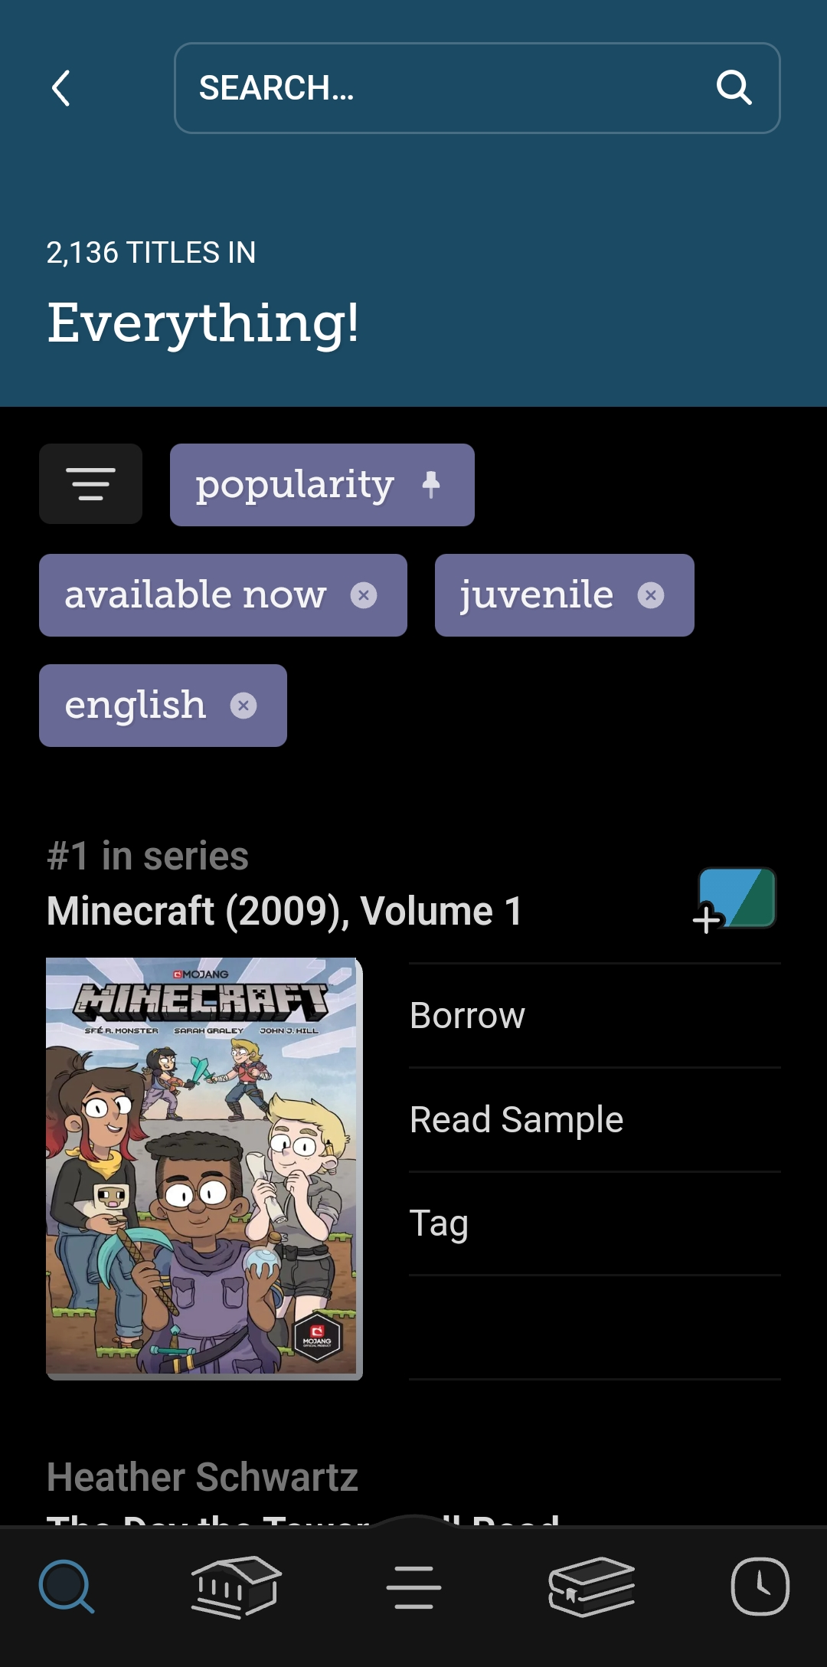
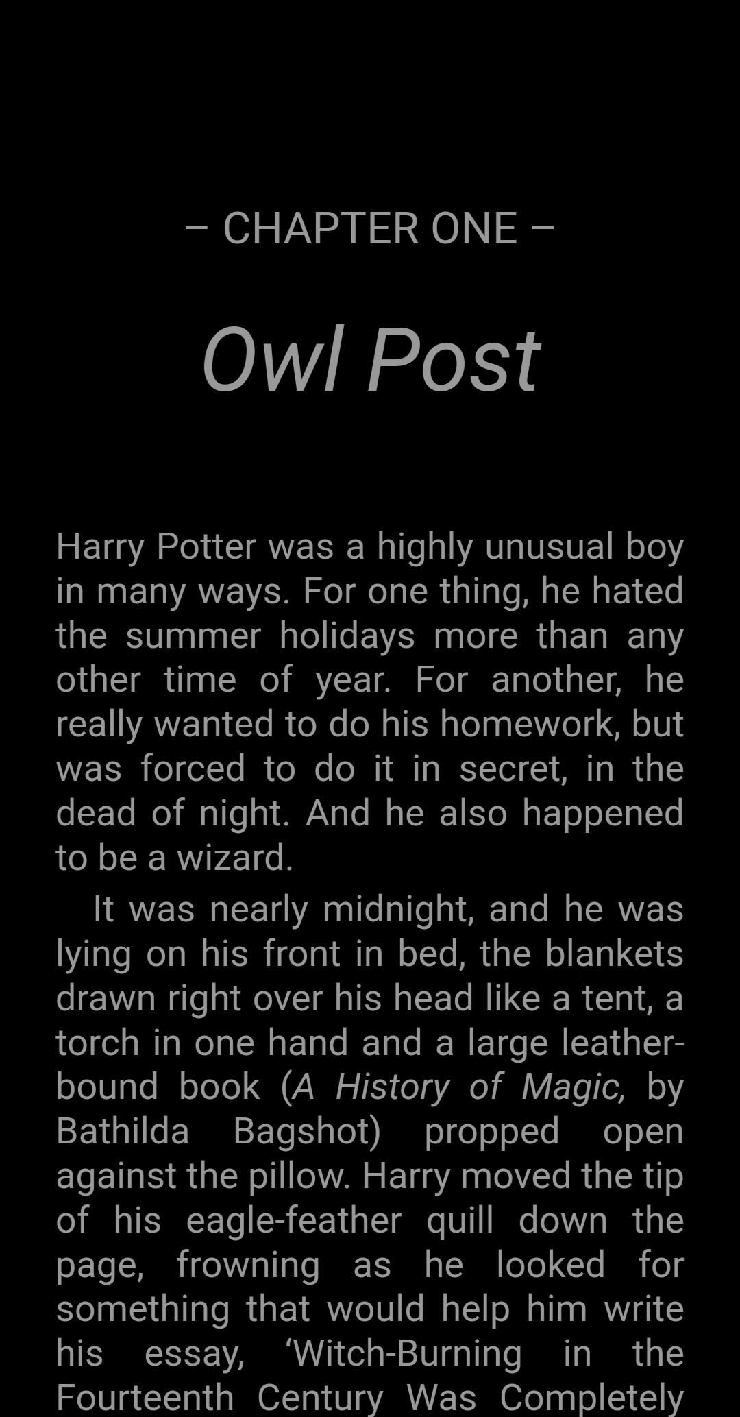

Reading - Libby
Sign up with your Surrey Library Card
Access e-books, comics, and audiobooks

Slide 12
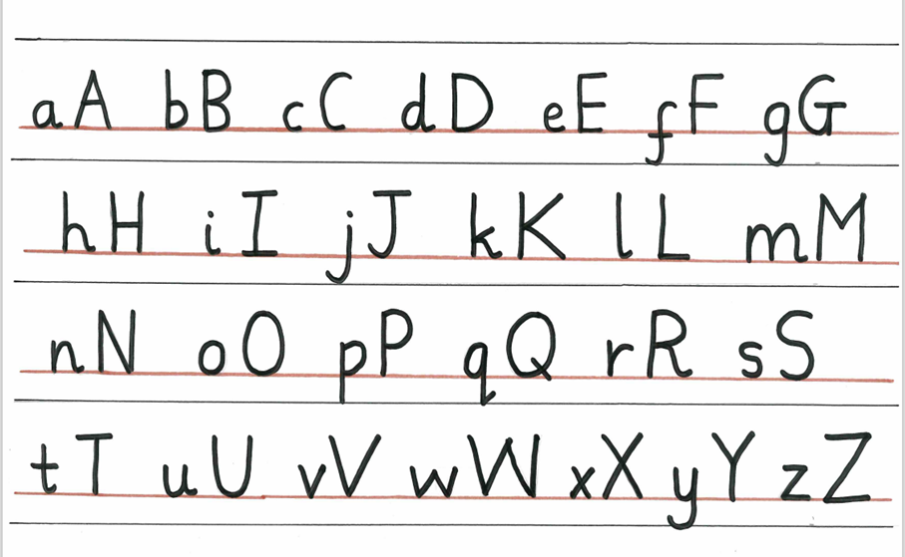
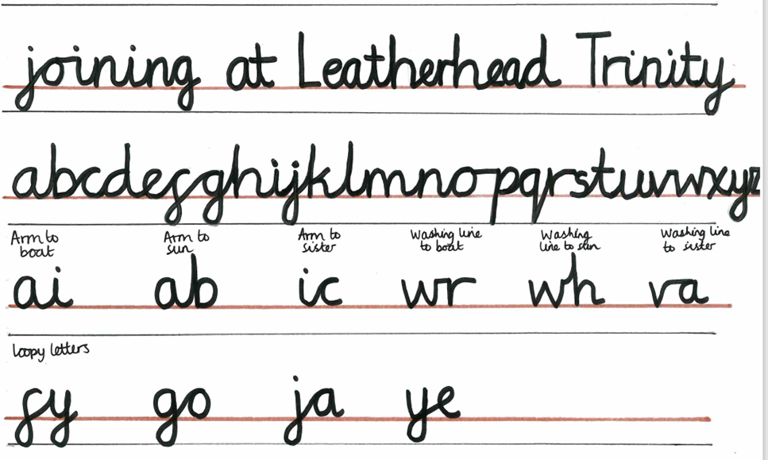
Handwriting + Presentation
We have a dedicated handwriting time first thing in the morning.
Children are taught correct letter formation.
It is vitally important that this correct letter formation is practiced frequently to allow it to become muscle memory.

Slide 13
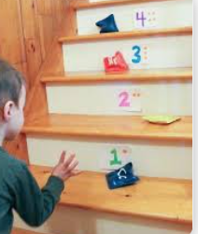


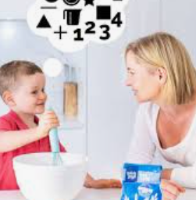

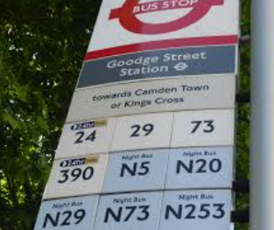

Supporting your child’s Maths skills
Turn everyday moments into mini math adventures that spark curiosity and joy!
Incorporate math into everyday tasks - such as counting toys while tidying, measuring ingredients, sorting clothes, counting steps, asking them to spot numbers or shapes on road signs.

Slide 14
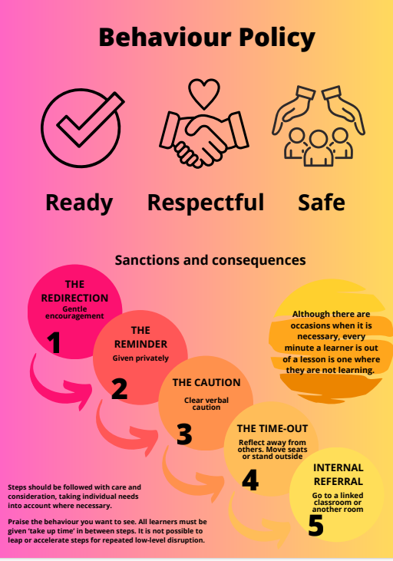

Slide 15
Dragonfly Class
Specialist Provision

Slide 16
We provide:
A positive, safe environment for every pupil.
Specialised teaching approaches which take into account each pupil’s learning style.
Meaningful and exciting opportunities for all through a broad, balanced and adapted curriculum to promote independence.
Inclusion opportunities in mainstream classes with support.
A focus on developing social and communication skills, joint attention skills and self regulation strategies.

Slide 17




Zones of Regulation
An approach to develop self-regulation

Slide 18
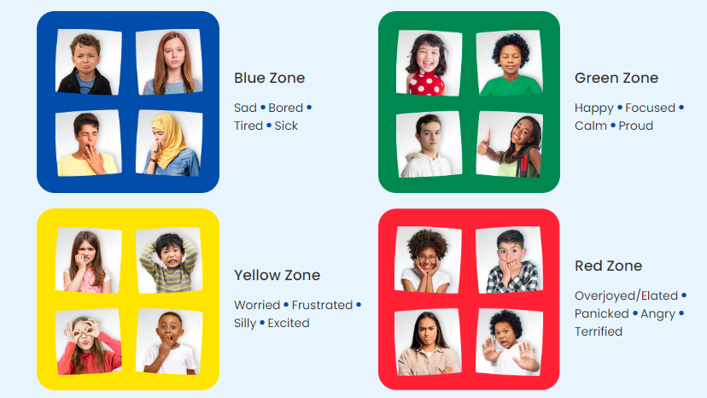
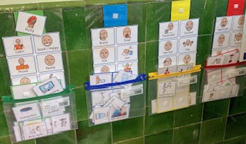
The Zones of Regulation provides clear visuals to help identify and communicate how we are feeling.
Children develop strategies to self-regulate .
Positive impact on social-emotional development.

Slide 19

Challenge for all
Challenge across the curriculum particularly in our continuous provision
To help children access learning we use a variety of manipulatives such as numicon, base 10 (diennes), rekenrek, multilink, word banks etc
Challenge for all – all children are able to access challenge and we are avoiding using glass ceilings for all children

Slide 20



Read daily for at least 5 minutes every day
Visit Edshed 3 times a week for 5 – 10 mins
Visit Numbots 3 times a week for 5 – ten mins
Additionally you will have access to the e-books
on Oxford Owl that match the level of books they read in their phonics sessions

Slide 21
Listen to your child read and promote a love of reading
Encourage your child to complete their weekly home learning by:
Encouraging them to access the online resources e.g. numbots, ed shed
Ensure your child has the correct named uniform and equipment – PE days are Thursday and Friday, wellies, raincoat and waterproofs needed for OPAL playtime and outdoor learning.

Slide 22
Wednesday 4th November
Book this date in your diary – PHONICS WORKSHOP

Slide 23

Thank You!
Any questions?

