Slide 1

Phonics Workshop
2025
How can I help my child?

Slide 2

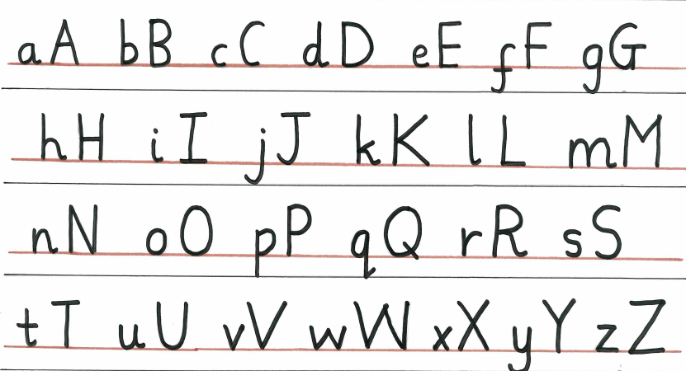
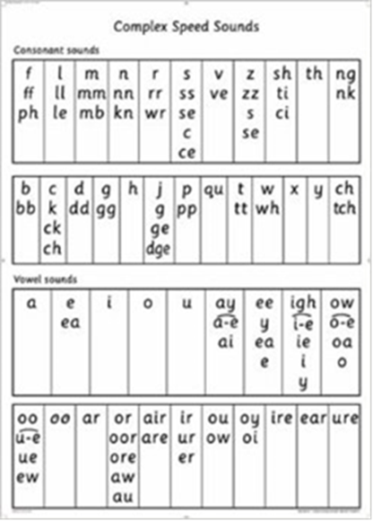
RWI links
Phonics lesson
Handwriting a high focus for us as a school and is taught as a whole class every morning. Children are not encouraged to join their letters until they are forming letters correctly (usually Y2)
15 minute speed sound session (newer phonics sounds)
The rest of the session then embeds reading and writing activities linked to the colour book children are on. This builds progressively on their phonics knowledge so only contains sounds they have already been taught.

Slide 3
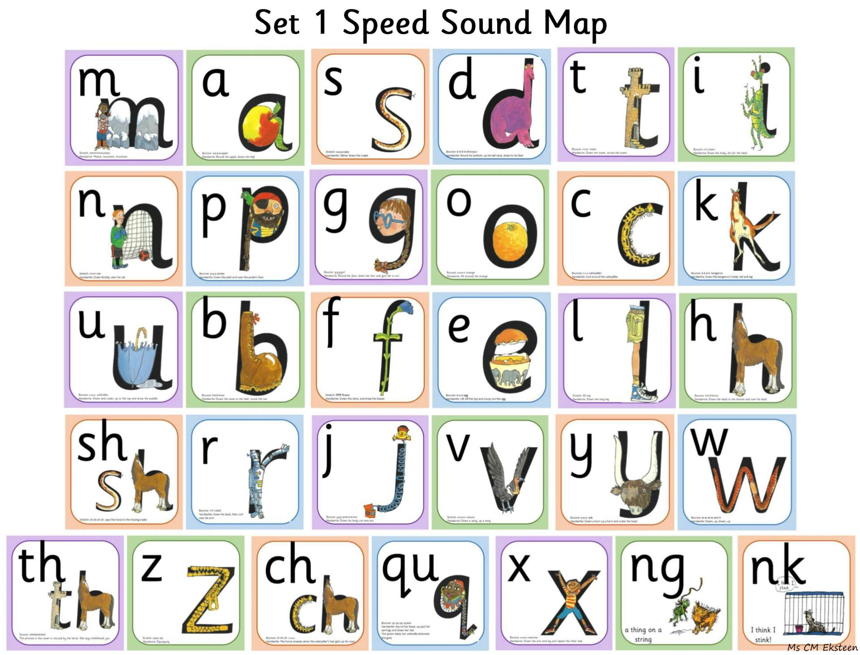
Reception
Special friends – 2 or 3 letters making 1 sound

Slide 4
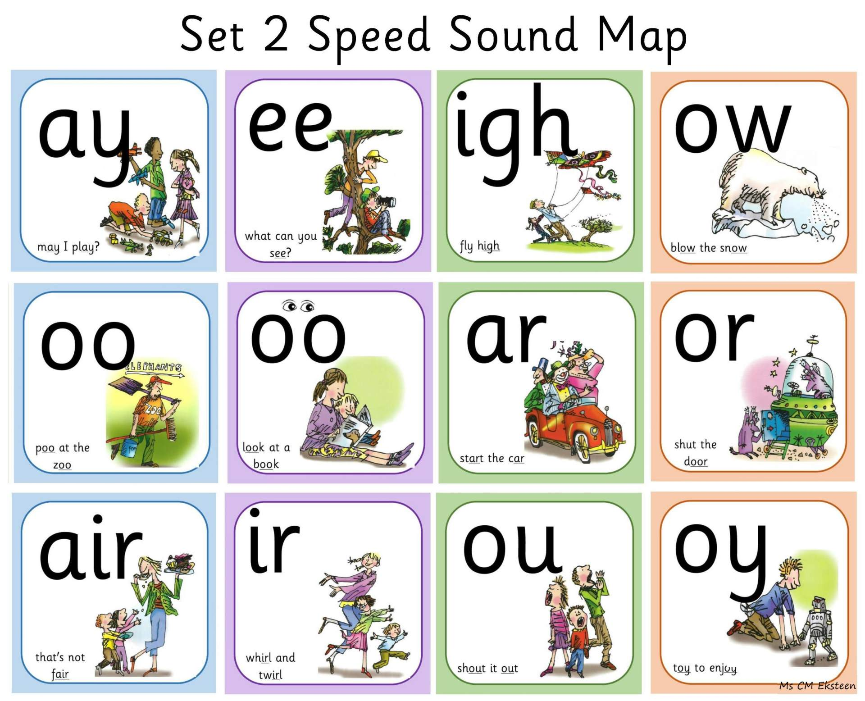
Reception/
Year 1

Slide 5
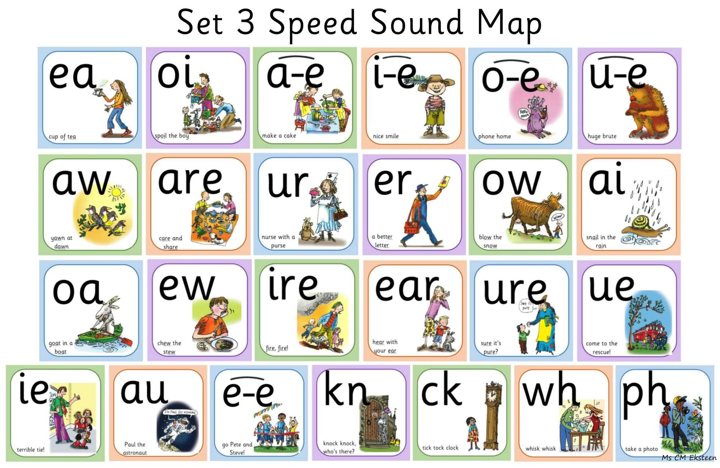
Year1 + Year2

Slide 6
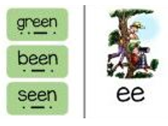
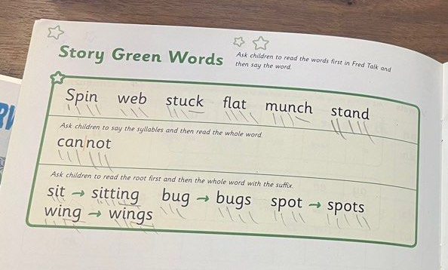
Green words
When children are taught new sounds, they read linked ‘green words’
Green = GO!
These words can all be sounded out.
Children have green words linked to the new sound, and green words linked to the story book they are reading.

Slide 7

Red words
Red words are the words that are not phonetically spelt.
Red = Stop and think!
We always look at the tricky part of the word when teaching this.
said

Slide 8

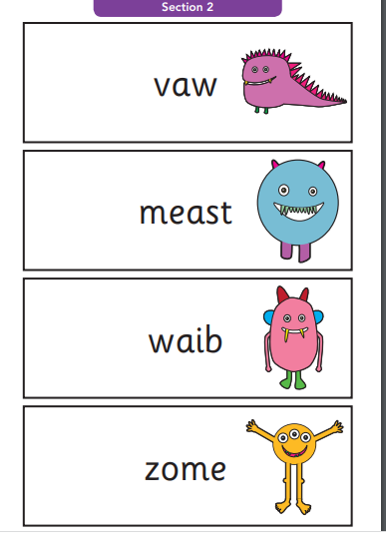
Reading assessment
Children are asked to apply their phonic knowledge to ‘alien’ words as well as real words.

Slide 9
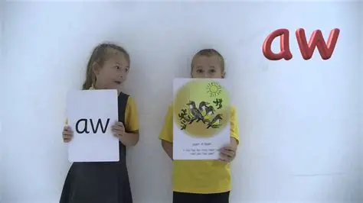
Speedy reading
Children will read the same words/ story a few times to build speedy reading and fluency
This is an essential part of their reading journey as reading takes a lot of practice!

Slide 10
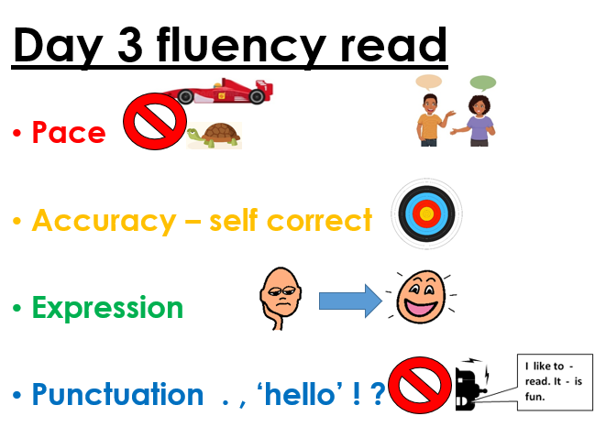
Fluency

Slide 11
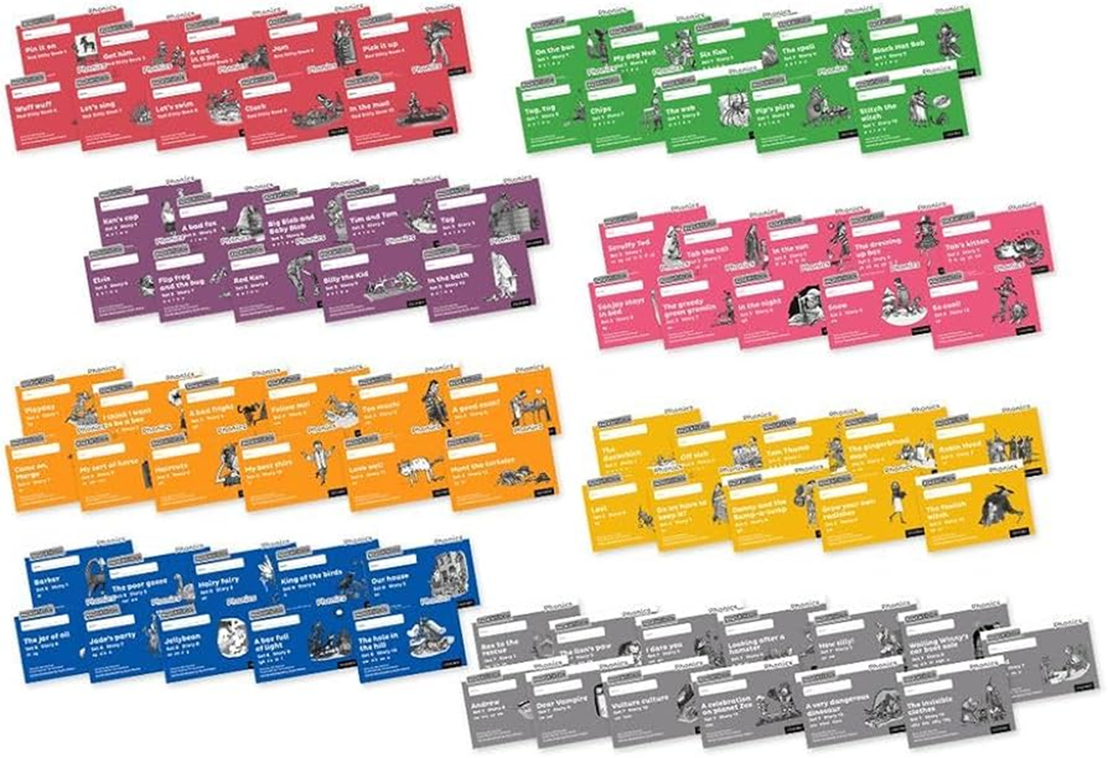
RWI books in order
Red
Green – end of reception
Purple – Autumn 1 Year 1
Pink –Autumn 2 Year 1
Orange – Spring 1 Year 1
Yellow – Spring 2 Year 1
Blue – Summer Year 1
Grey – literacy groups

Slide 12
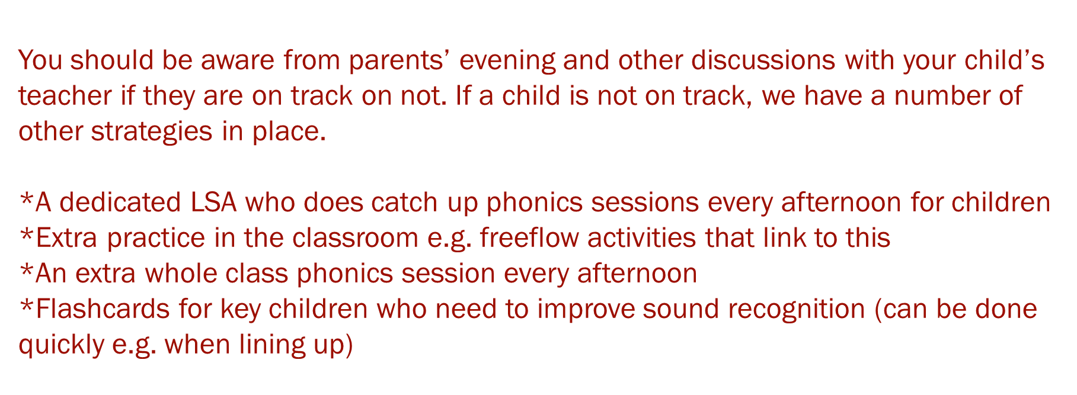
What happens if my child is not on track?

Slide 13

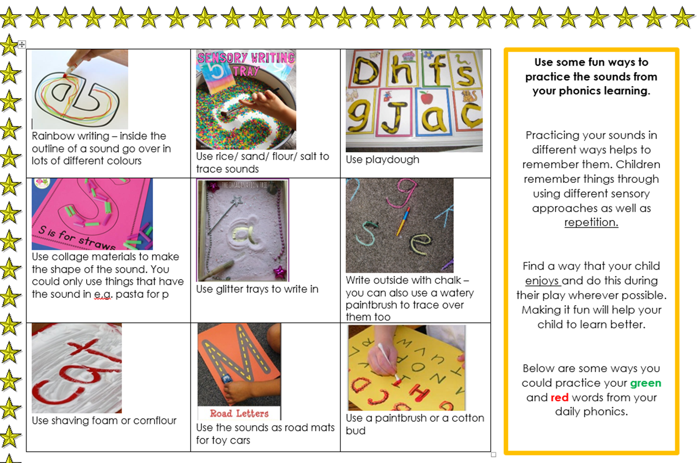
Make sure you know what sound gaps your child has, or what element of reading they find more challenging.
Read at home every day – even if you read to them! It can also help to take turns reading pages or sentences.
Re-read the phonics linked home books – this helps embed the learning.
Practice the speed sounds in fun ways!

Slide 14
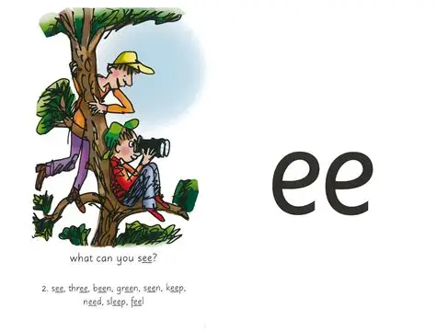
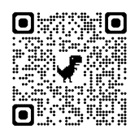
Videos for parents
Mrs Harris made lots of videos during lockdown that will support your child with learning the phonic sounds. We will let you know which sounds to practice at home. They are very short and will reinforce the learning in school.
If your child needs extra support, keep the words short e.g.
see, bee, tree
If your child needs a challenge, use longer words (add ing/ed where possible) and focus on speedy reading
sleeping, peeled, freeze, cheesecake!
https://vimeo.com/1128873894
Password for each one is Trinity.

Slide 15


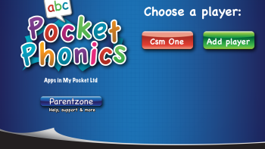

https://www.phonicsplay.co.uk/
These do not link to the RWI taught order but still give the children good practice!
https://www.topmarks.co.uk/english-games/5-7-years/letters-and-sounds
https://www.phonicsbloom.com/

Slide 16
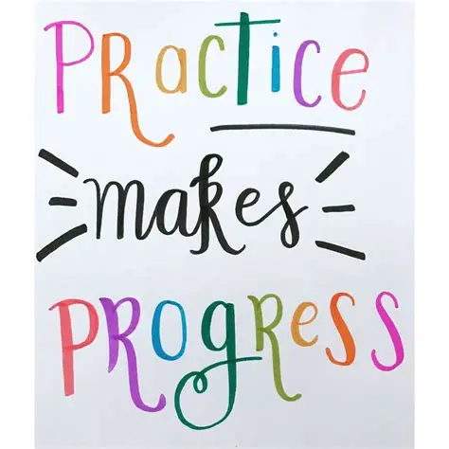

Slide 17

Thank You!
Any questions?

