Slide 1

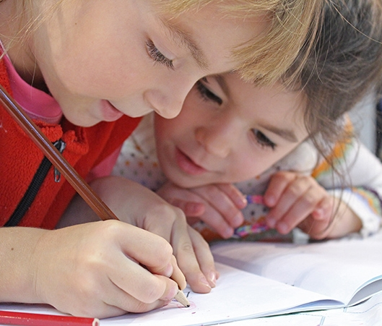
Meet the teacher
September 2025
Welcome to Year

Slide 2

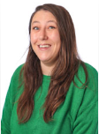






Staff
Mrs Ingle Year 3
Miss Stretch Year mixed year 3 and 4
Miss Tolley 4
Mrs Celine
Mrs Townsend
Mrs Duarte
Mrs Hearley
Mr Duckworth

Slide 3
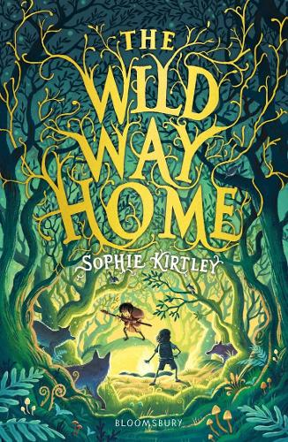
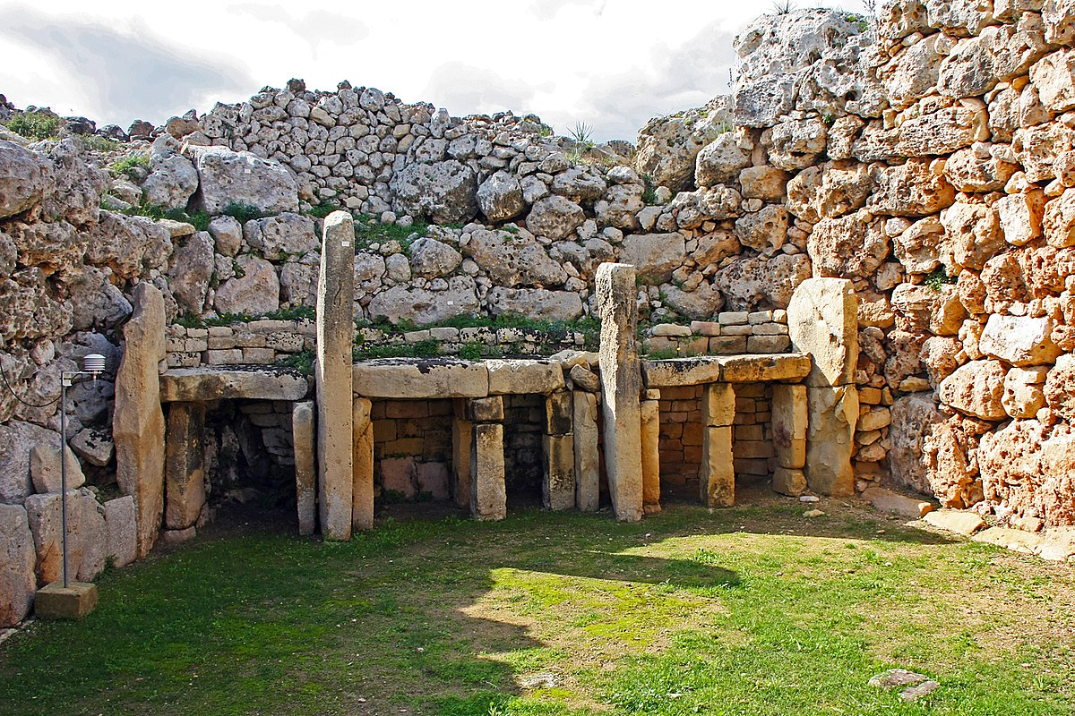
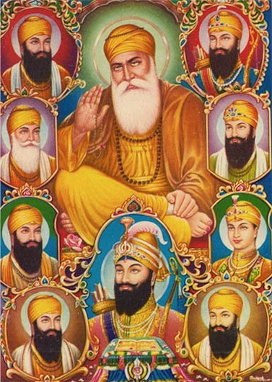
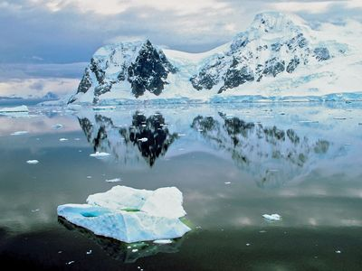
AUTUMN TERM:
History- The Stone Age
Geography - Antarctica
Guided reading text- ‘Wild Way Home’
Science- Animals including humans
Art- Charcoal
DT-Structures: Mechanical system
R.E- Sikhism and Christianity
TRIPS:
Autumn 2 – Natural History Museum

Slide 4



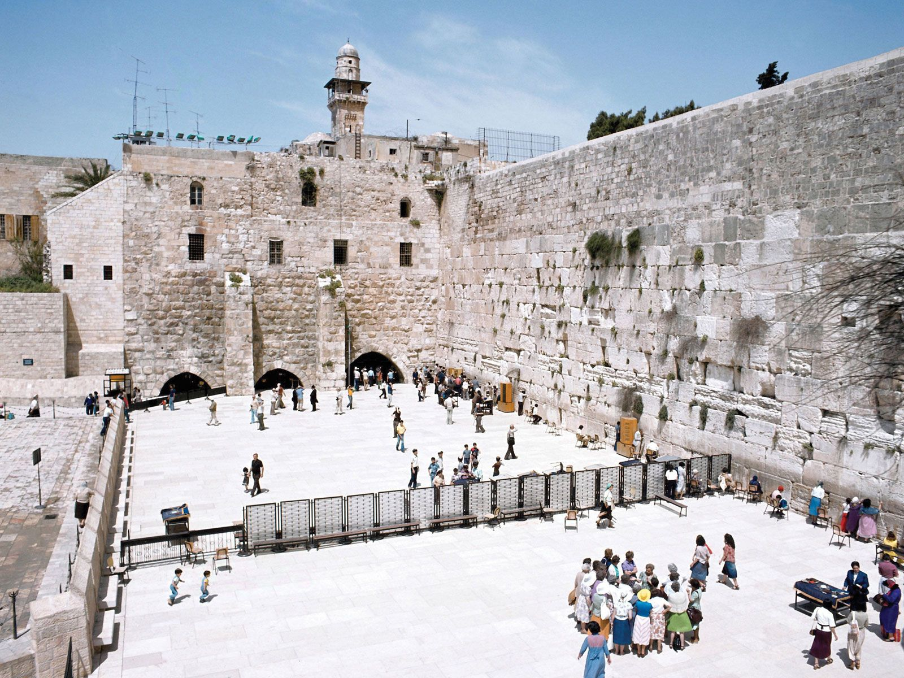
SPRING TERM:
Guided reading text- ‘Delta and the Lost City’
Science- Forces and Magnets and Rocks
Geography- Volcanoes
History – Romans and Celts
Art- Surface and Colour
DT – Food
R.E- Judaism and Christianity
TRIPS:
*Faversham Roman palace
*Pizza Express

Slide 5
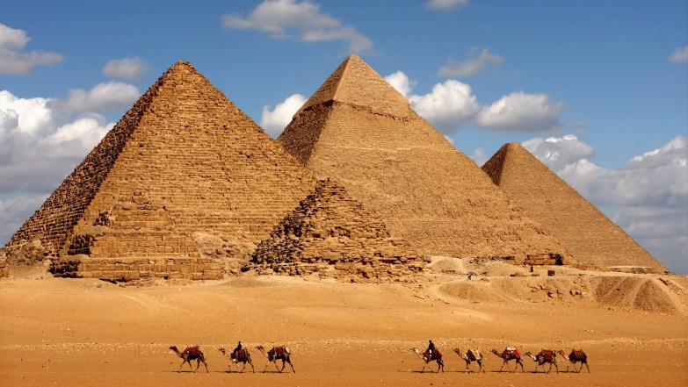
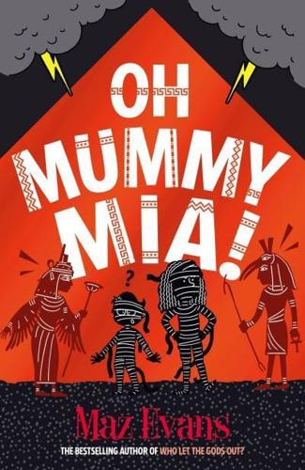
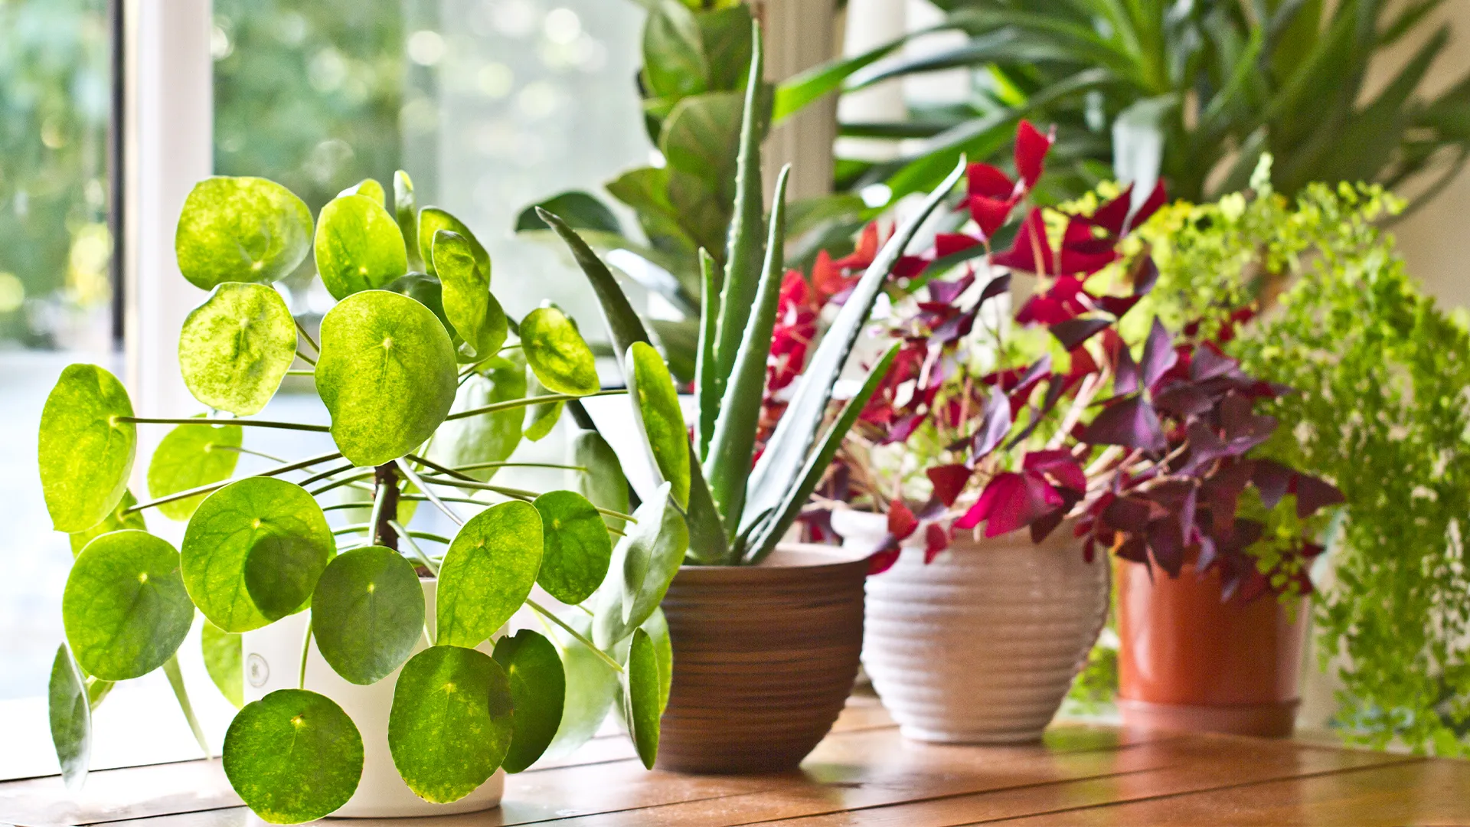
SUMMER TERM:
History- Ancient Egypt
Geography – Different types of Settlement
Guided reading text- ‘Oh Mummy Mia’
Science- Plants and Light
Art- Working in 3D
DT- Structures
R.E-Christianity and Art through Religion
TRIPS:
British Museum
Local town trips

Slide 6
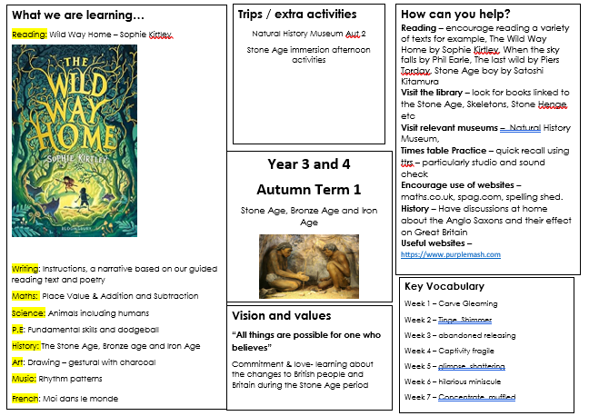

Slide 7
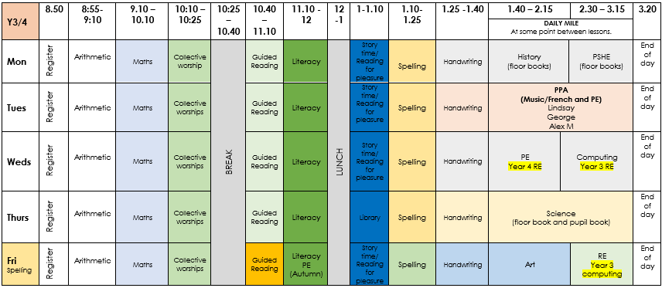
Timetable

Slide 8
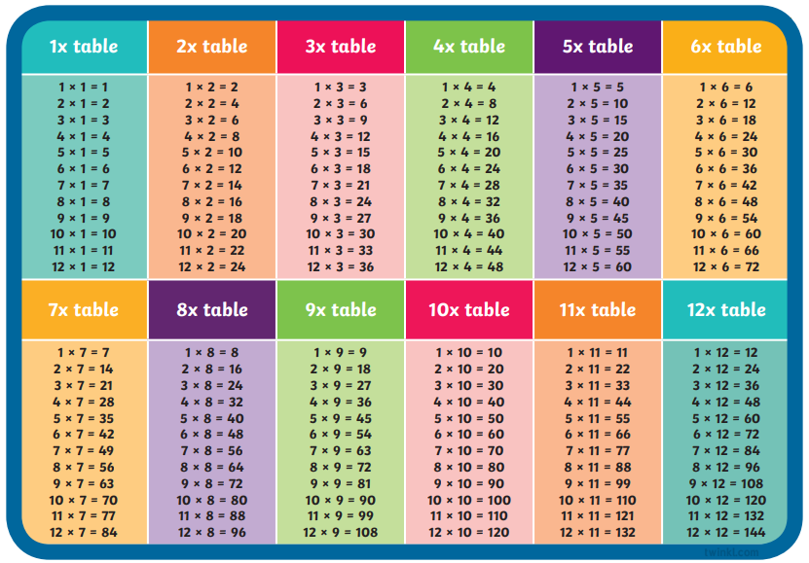

Multiplication Check
In Year 4, all children are required to complete a times table check to test their recall on all times tables facts.
We strongly recommend you use the soundcheck on Times Tables Rockstars to practice.
Other ideas: Hit The Button, listening to times table songs, writing them out or creating your own games with them.
Add pictures of key texts

Slide 9


Supporting maths at home:
Incorporate mathematics into everyday routines and activities; telling the time, using money and coins or counting and comparing quantities. A parent or puppet can make deliberate errors in counting and sharing, with the child encouraged to identify these mistakes.
Use maths talk every day. For example, how many pennies are you holding? Or what shape is that object? Focus on concepts like doubling/halving and adding/subtracting. If I ate half the peas on your plate for you, how many would you have left?”
Ask your child to teach you new strategies and solve problems taught in class.
Play maths games together. Many games use mathematical and logical skills that your children will need in later life - plus they’re fun! Games like jigsaw puzzles help children to develop logical & spatial awareness skills. Board games with dice develop children’s counting skills.
Use fractions in daily life. Can you find ½ of the sweets? What fraction of the cake has been eaten?
Practice times tables and maths games online. Times table rock stars, Sumdog, Hit the Button are all useful websites.
If they need a challenge… Explore websites such as NRICH (http:// nrich.maths.org/) or Transum (http://www.transum.org/)

Slide 10
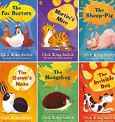


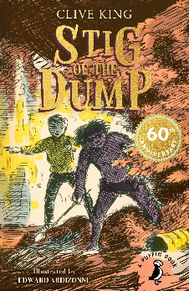
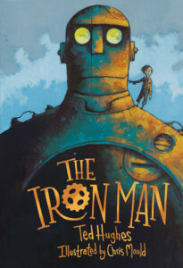
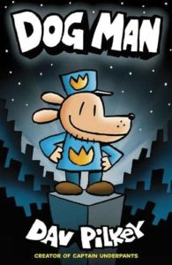

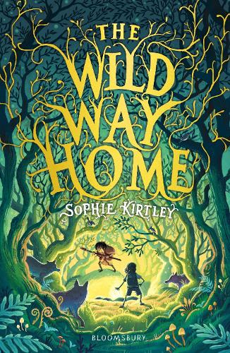

Reading
Author of the term
  Dick King Smith
  Enid Blyton
  Michael Morpurgo
Old and gold/new and bold
  Guided Reading texts

Slide 11
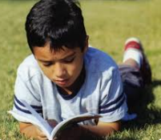
Reading
Home Reading
5 times (weekly)
Children/adults make comments
Reading to your child
Audio books
Library
Reading bingo
Reading at school
Guided Reading
Reading across the wider curriculum
Reading for pleasure
Morning reading

Slide 12
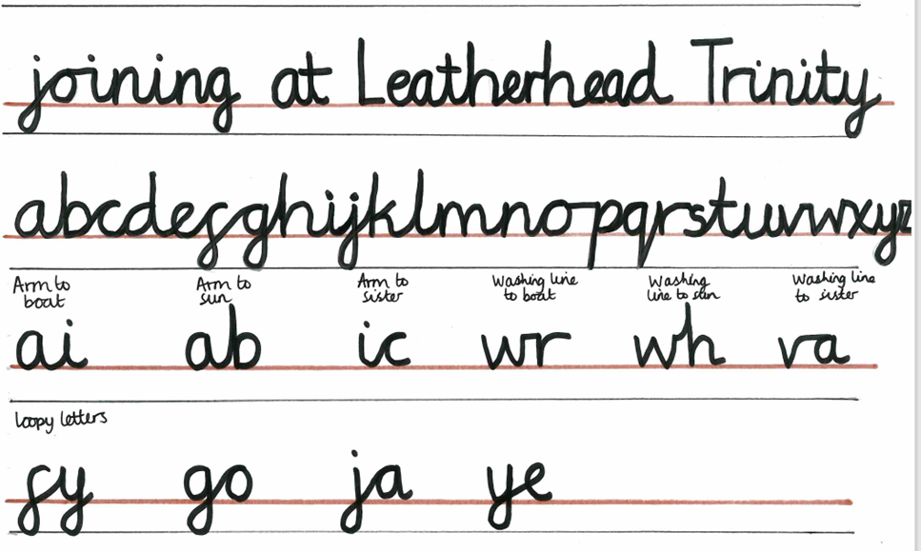
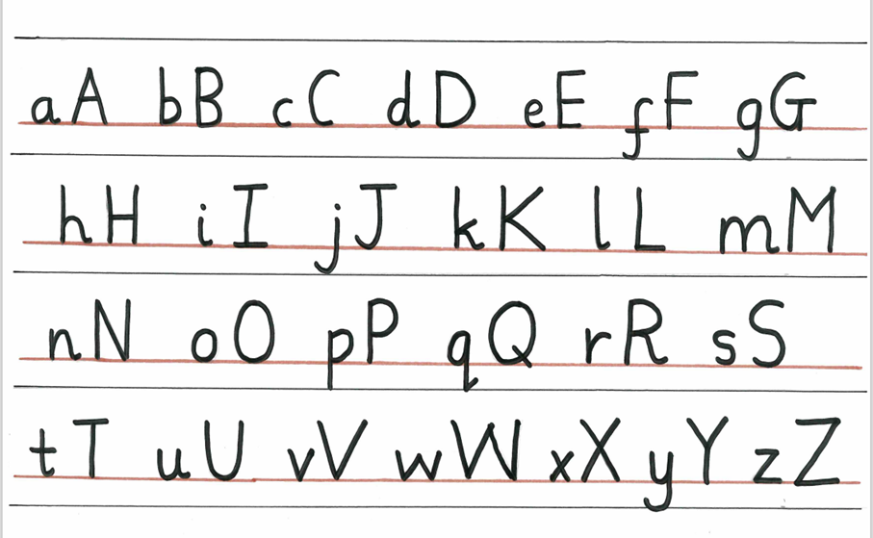
Handwriting + Presentation

Slide 13
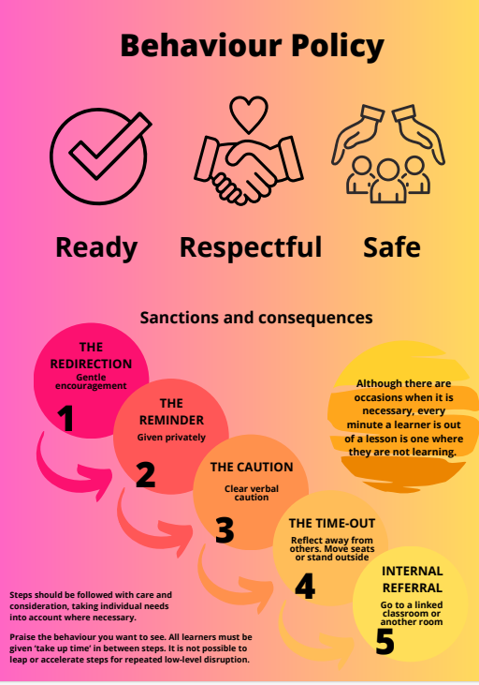

Slide 14
Ready, Respectful, Safe
Recognition board – all children recognised for positive behaviour
Re-direct, remind, caution – all done privately with the child
Time outs still take place but white slips are for recording purposes only
All adults responsible and consistent

Slide 15
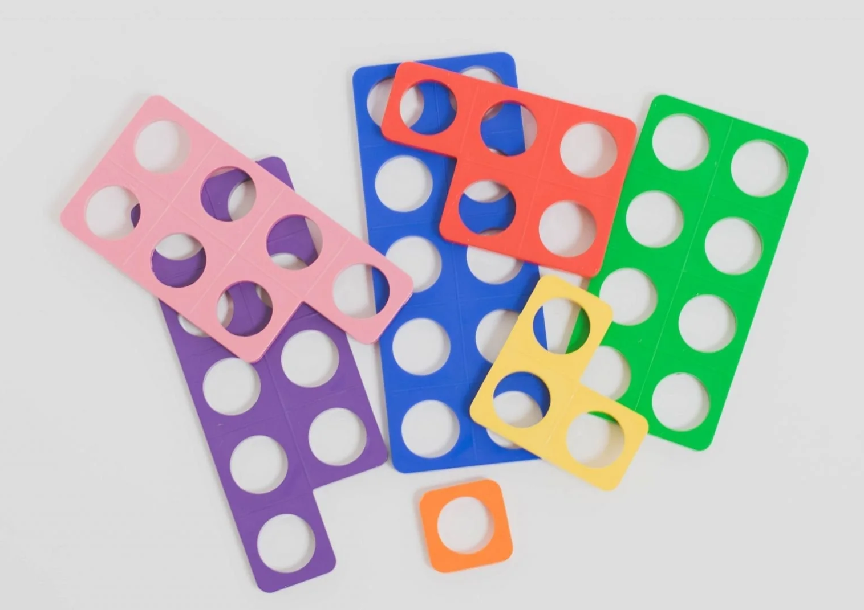
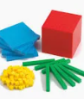
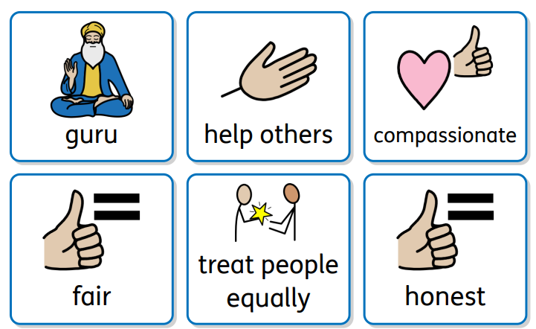
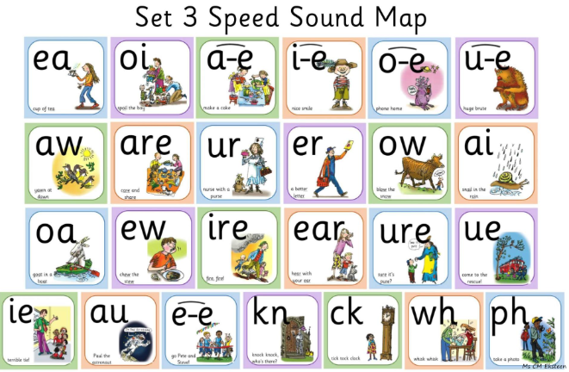
Challenge for all
Helping children to access their learning:
Manipulatives (dienes and numicon)
RWI sound mats
Widgits – word banks
Challenge for all
All children able to access challenge

Slide 16

Ready, Respectful, Safe
Supporting us to help your child be ‘Ready’ for their learning
  Sleep
  Filling breakfast
  Attendance/punctual
  Supporting our rules: Ready, Respectful and Safe
Home learning
  Reading at home (5x over the week)
  TTRS
  Spellings

Slide 17

Thank You!
Any questions?

