Slide 1
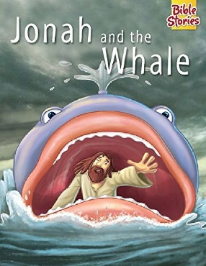
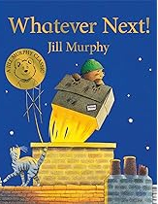
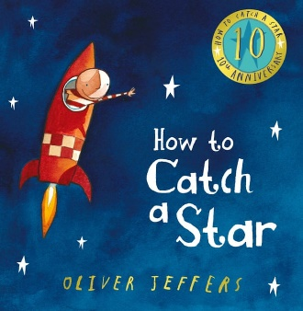
Key Texts and Songs
Twinkle Twinkle
Zoom, Zoom, Zoom
5 aliens in a flying saucer
Key Value – Love
Communication and Language
Use a wider range of vocabulary
Understand longer stories and remembers much of what happens
Use longer sentences
Space
This is our topic this half term and these are the main curriculum targets we are focusing on. We adjust these targets according to each individual child.
PSED
Play with one or more other children.
Remember rules without needing reminding.
Maths
Comparing size and weight of objects.
Know that the last number reached when counting is the total.
Link numeral to amount.
2D shapes.
Literacy
Spot and suggest rhymes.
Recognise words with the same initial sound.
Name different parts of a book.
Develop play around books.
Give meaning to marks.
Physical Development
Eat independently.
Use a comfortable grip with good control.
Make snips in paper with scissors.
Climb on apparatus using alternative feet.

Slide 2
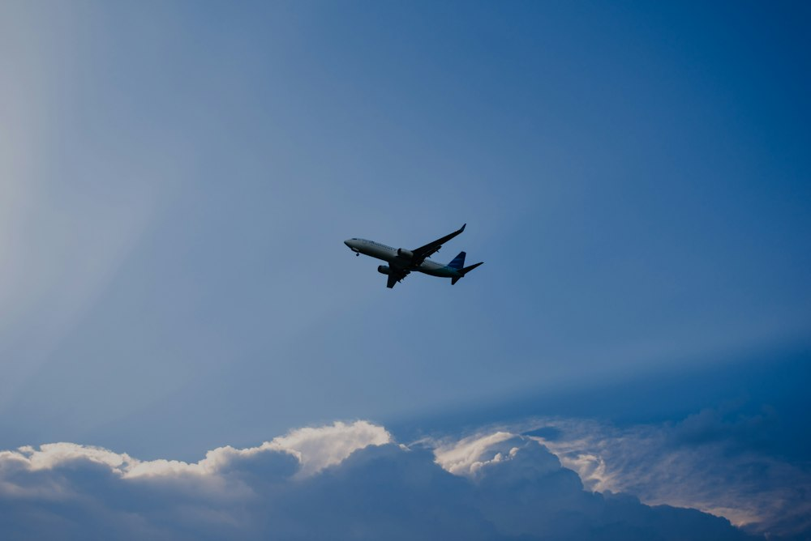
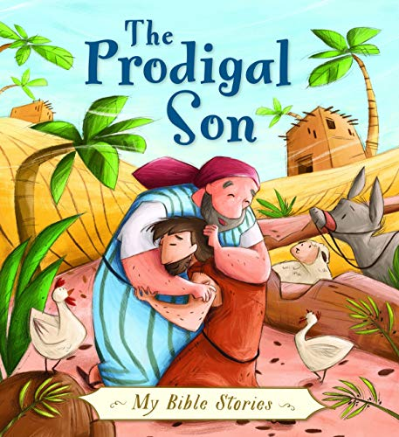
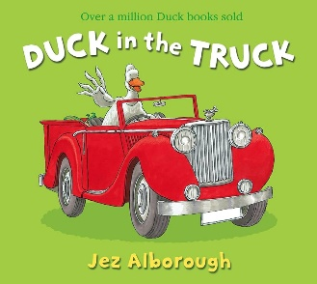
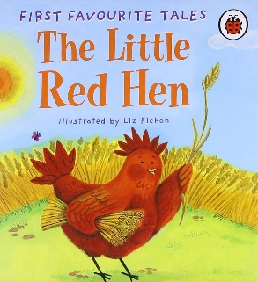
Key Texts and Songs
The wheels on the bus
I’m a little seed
5 little speckled frogs
Key Value – Forgiveness
Communication and Language
Understand 2 part instructions.
Retell longer stories and remember much of what happens.
Start a conversation and continue it for many turns.
PSED
Become more outgoing with unfamiliar people.
Increasingly follow rules.
Transport
Expressive Arts and Design
Draw with increasing detail.
Take part in pretend play.
Make up narratives with people and animals .
Physical Development
Put on coat independently .
Show preference for dominant writing hand.
Work with others to move large objects.
Balance on bikes .
This is our topic this half term and these are the main curriculum targets we are focusing on. We adjust these targets according to each individual child.
Understanding the World
Talk about how materials change.
Talk about different occupations.
Plant seeds.
Maths
Know that the last number reached when counting is the total.
Link numerals to the amount of objects .
Use and understand prepositions (over, under, on top, next to, behind).
Build structures that are more complex than a tower.
Literacy
Recognise words with the same initial sound.
Write a pretend shopping list.
Begin to write most of their name.
Notice print around them.

